Slide 1
Seismic Infrastructure in Portugal
Fernando Carrilho
ORFEUS/EPOS Workshop
25 – 27 October 2017, Lisbon, Portugal

Slide 2
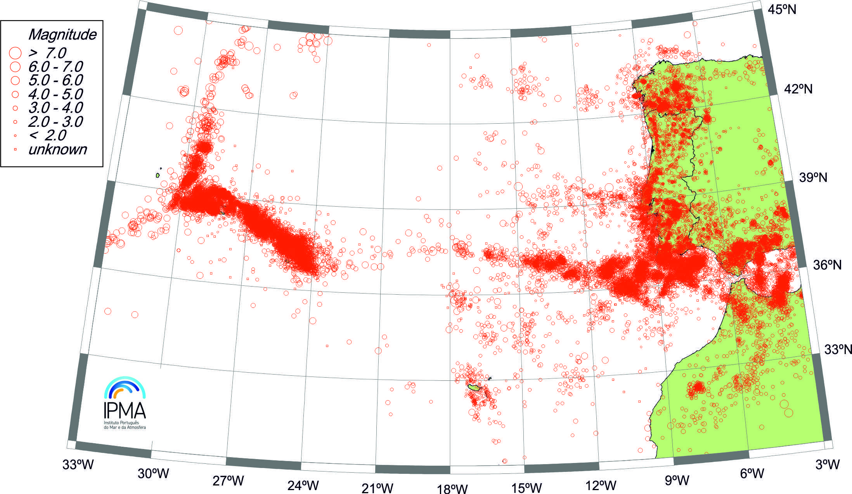
Azores-Madeira-Mainland Seismicity
1961-2016
Azores
Madeira

Slide 3
Upgraded network
Developments:
Quality data acquisition in highly sensitive stations which are also equipped with strong-motion sensors
Higher quality digital transmission
Real time monitoring at the Operational Center
Automatic signal detection
Automatic association of detections, event location and magnitude evaluation
Development of a rapid earthquake information system for Civilian Protection authorities
Automatic archive of recorded data
Development of high-level products (bulletins, shakemaps, regional moment tensor, etc.)‏
Contribute to international monitoring efforts (FDSN, ORFEUS, tsunami projects [NEAMTWS])‏
Data for scientific research purposes

Slide 4
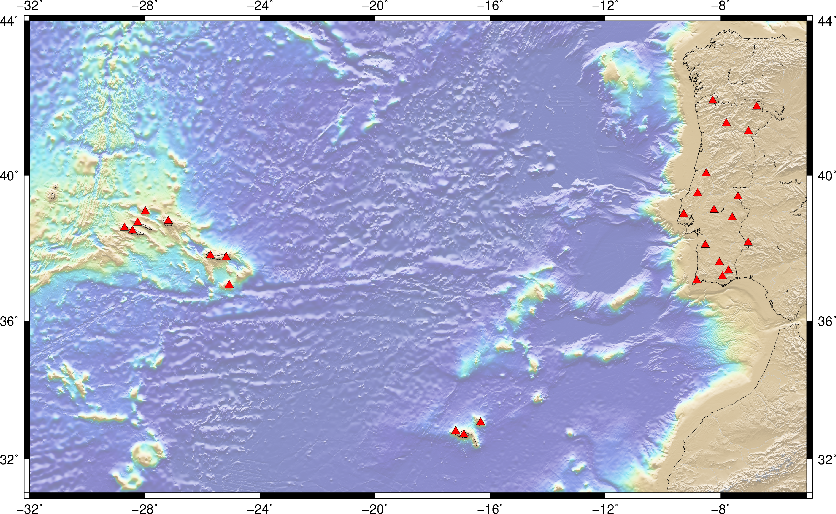
IPMA Broadband Network 27 stations

Slide 5
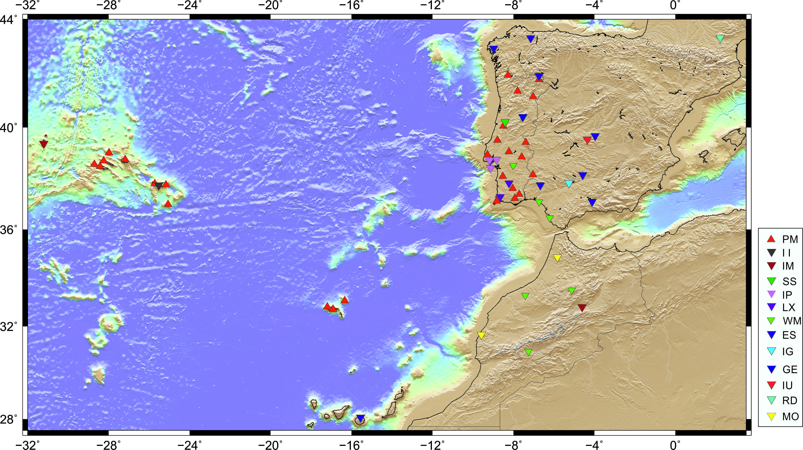
Extended Regional Broadband Network 62 stations

Slide 6
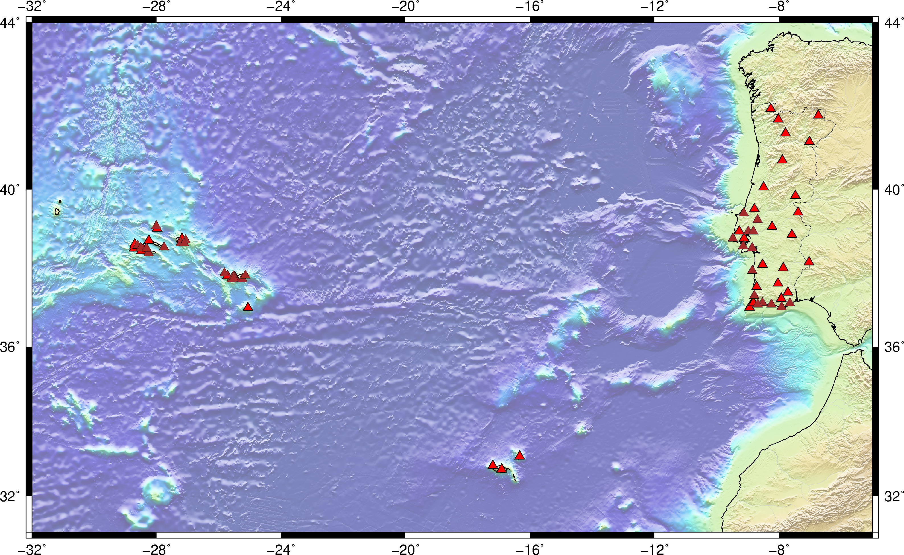
Strong Motion Network 66 stations

Slide 7
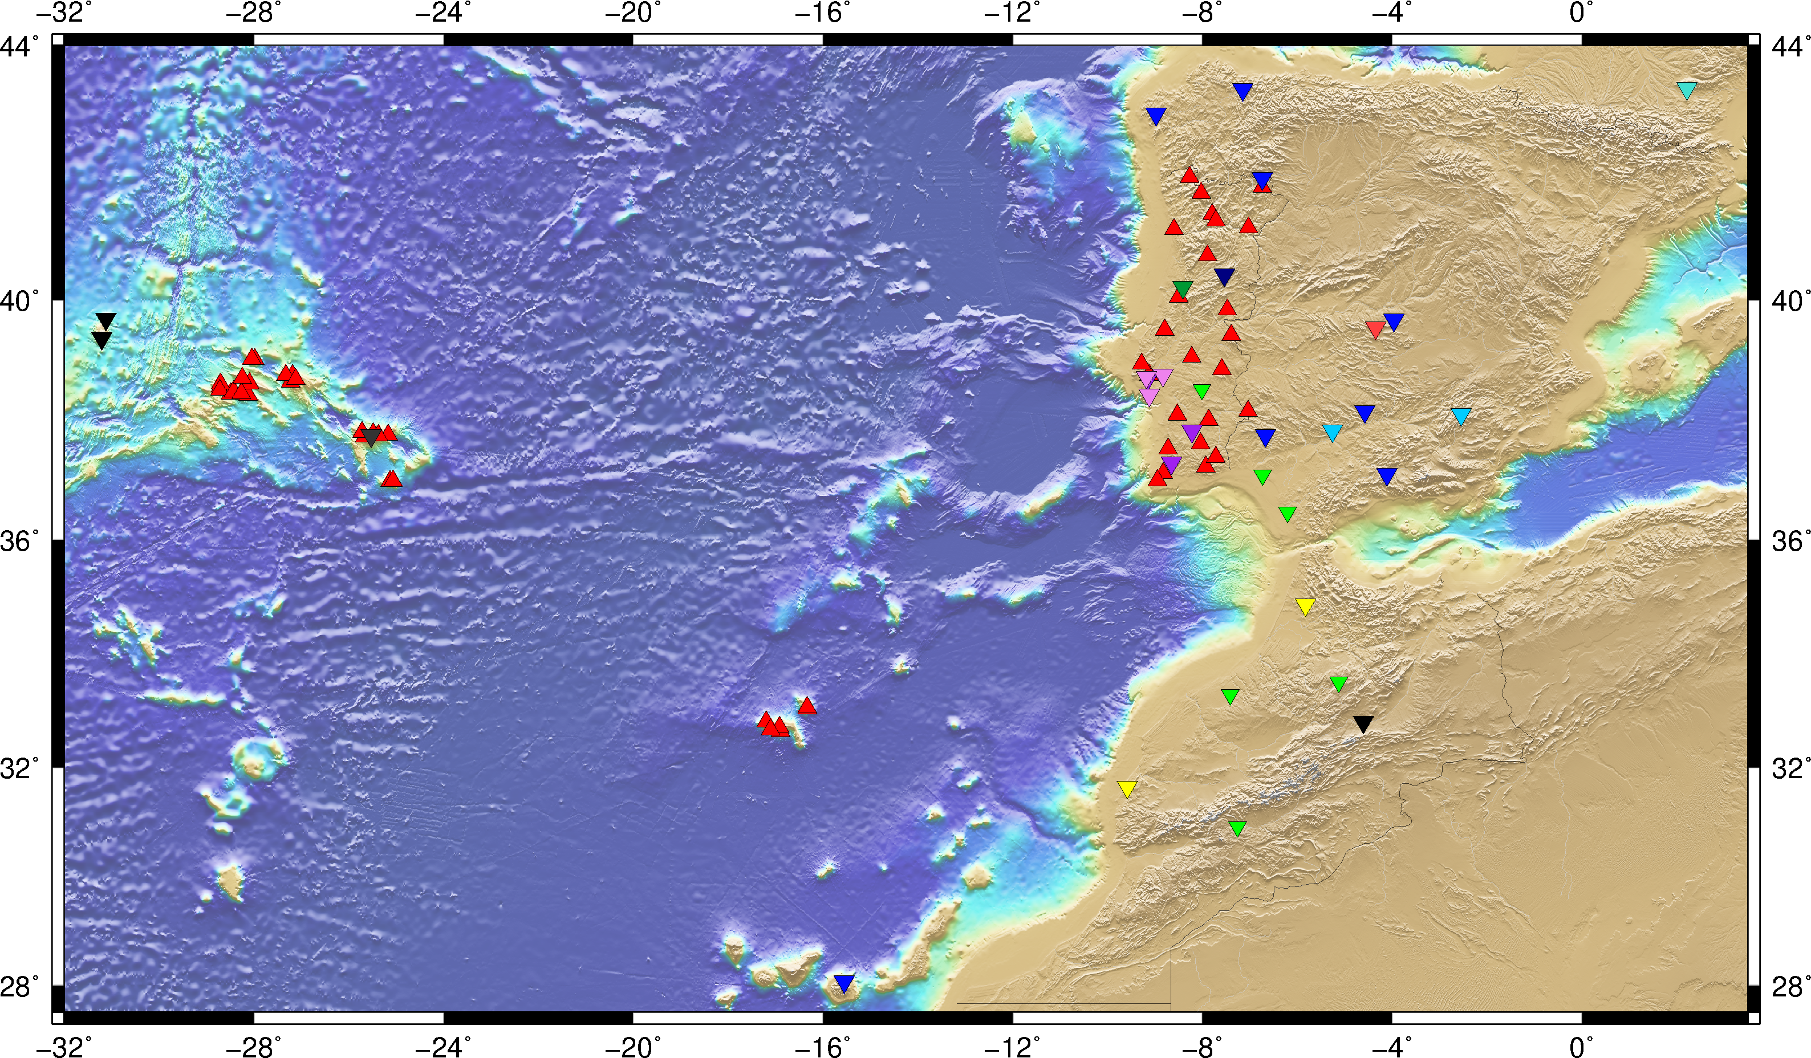
The Regional Network 117 stations

Slide 8
Seismic stations
Sensors
Digitisers/Dataloggers
Communication
Guralp CMG-3T (120sec)
Guralp CMG-3ESPc (120sec)
Streckeisen STS-2 (120sec)
Lennartz LE3D20 (20sec)
Lennartz LE3D5 (5sec)
Lennartz LE3D1 (1 Hz)
Guralp CMG5T
Kinemetrics Episensor
Nanometrics TITAN
Guralp DM24
Guralp EAM6
Nanometrics CENTAUR
Geosig GSD24
Geosig GMS+
Mars88 (Obsolet)
Alpha2000
Alix1D
VSAT
DSL
GPRS

Slide 9
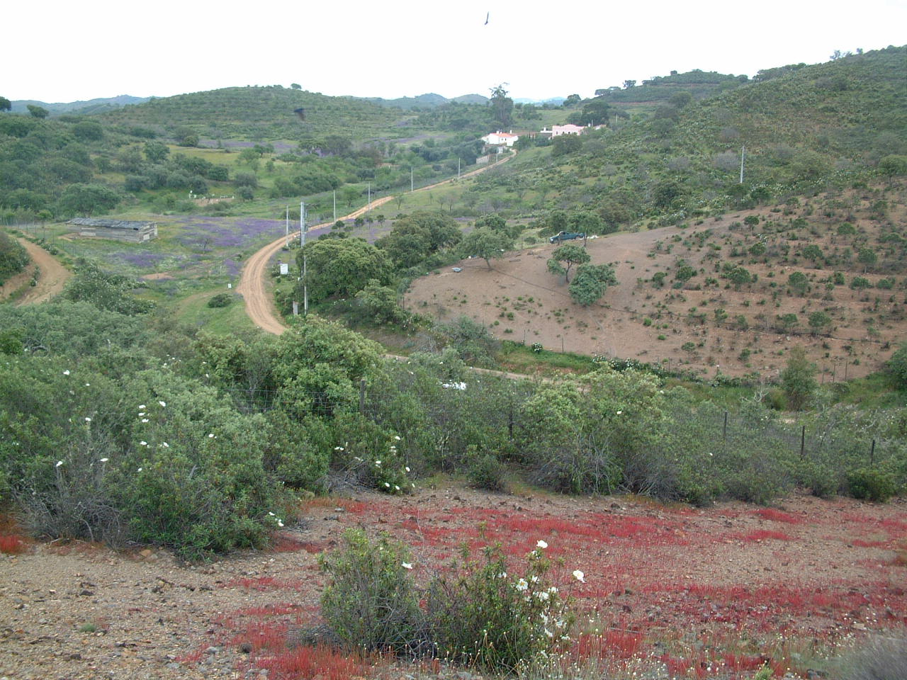
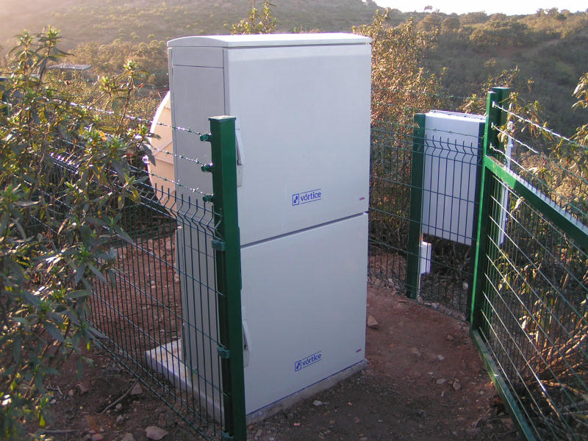
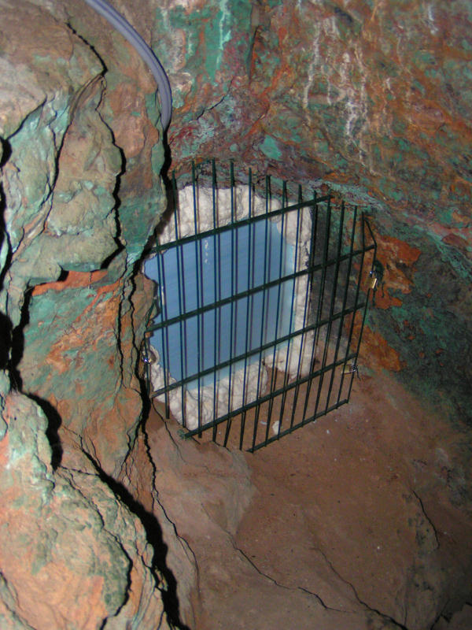
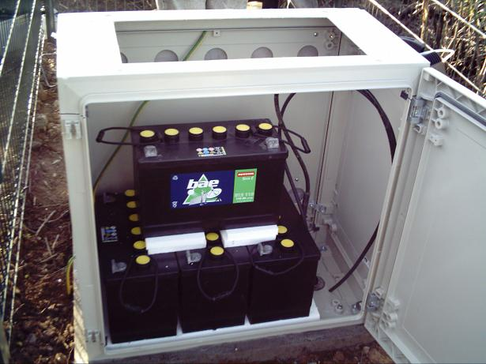
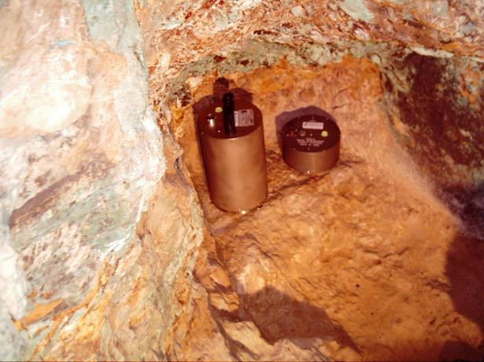
Seismic stations
PVAQ (Vaqueiros)‏

Slide 10
Seedlink flow
VSAT
23 stations
Internet
71 stations
MPLS
6 stations
VPN’s over Internet
17 stations
CEA
Archive
(storage area network)‏
DMC
TREMOR
GFZ
IPMA firewall
mplsserver
NRT processing
(autopick & autoloc & SOH)‏
ODC
Check&
register
(data_extract)
Automatic& Manual Analysis
(SEISAN)‏
imslserver
IGN
IPMA DMZ's
partners
IPMA LAN
IPMA firewall

Slide 11
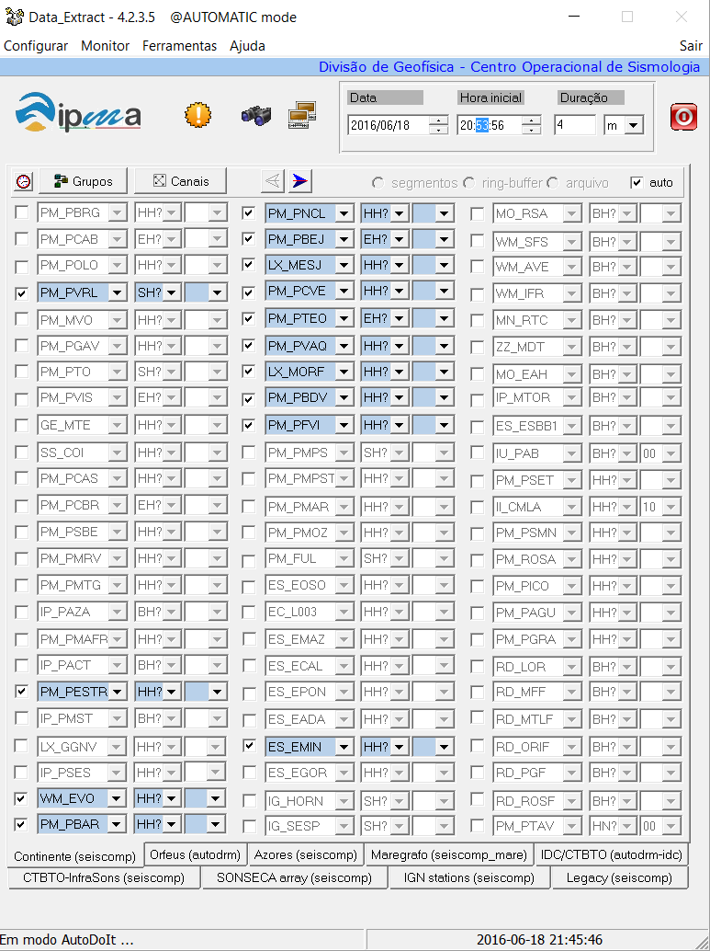
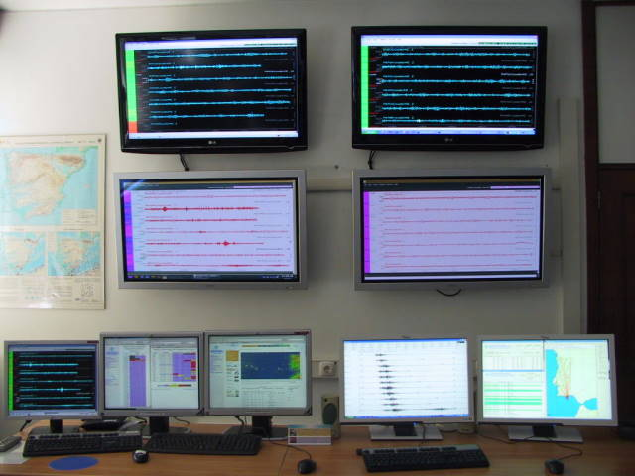
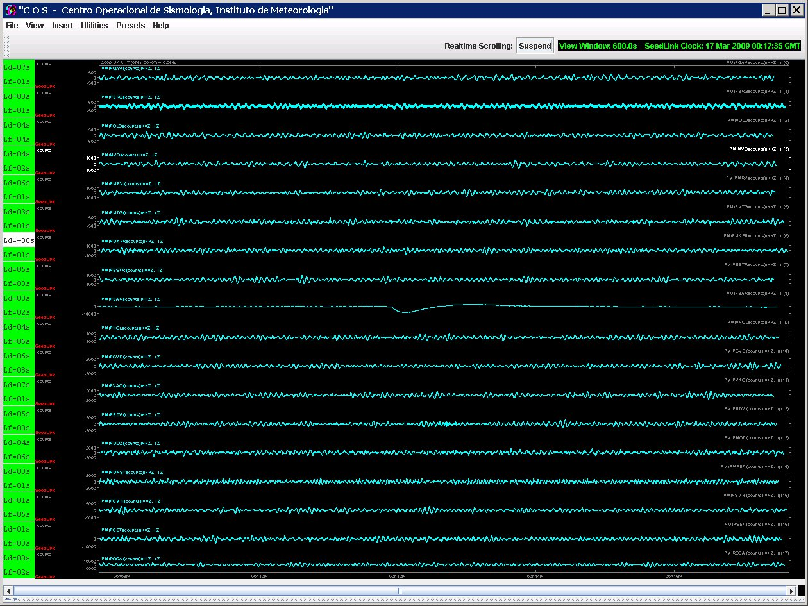
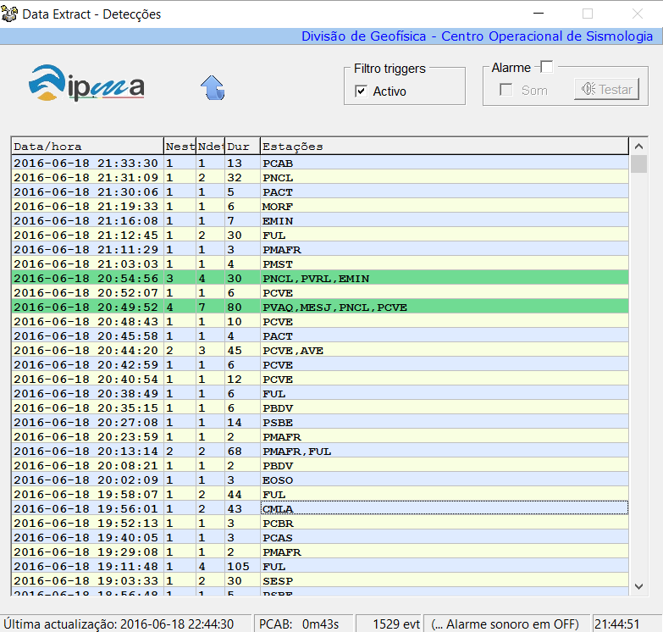
Real-Time Seismic Monitoring

Slide 12
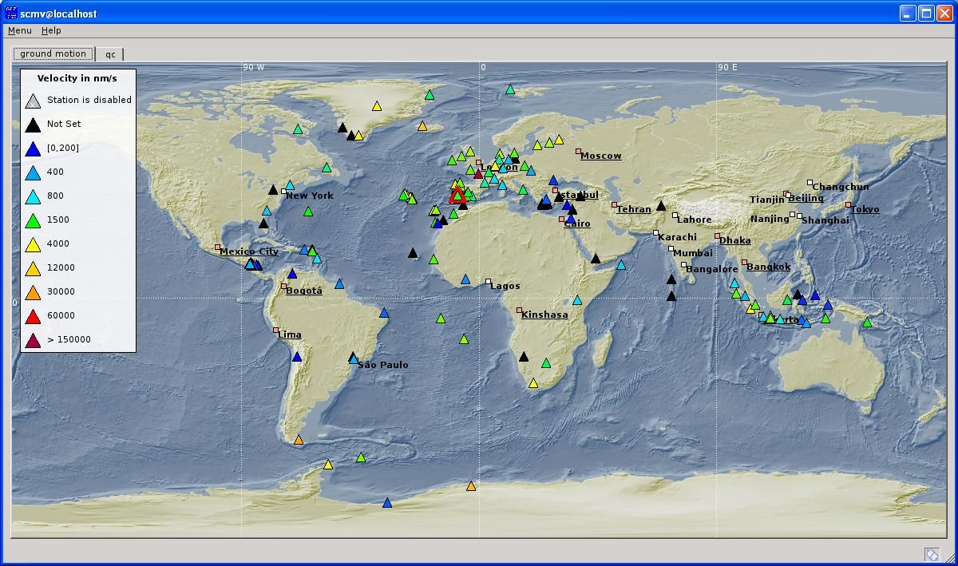
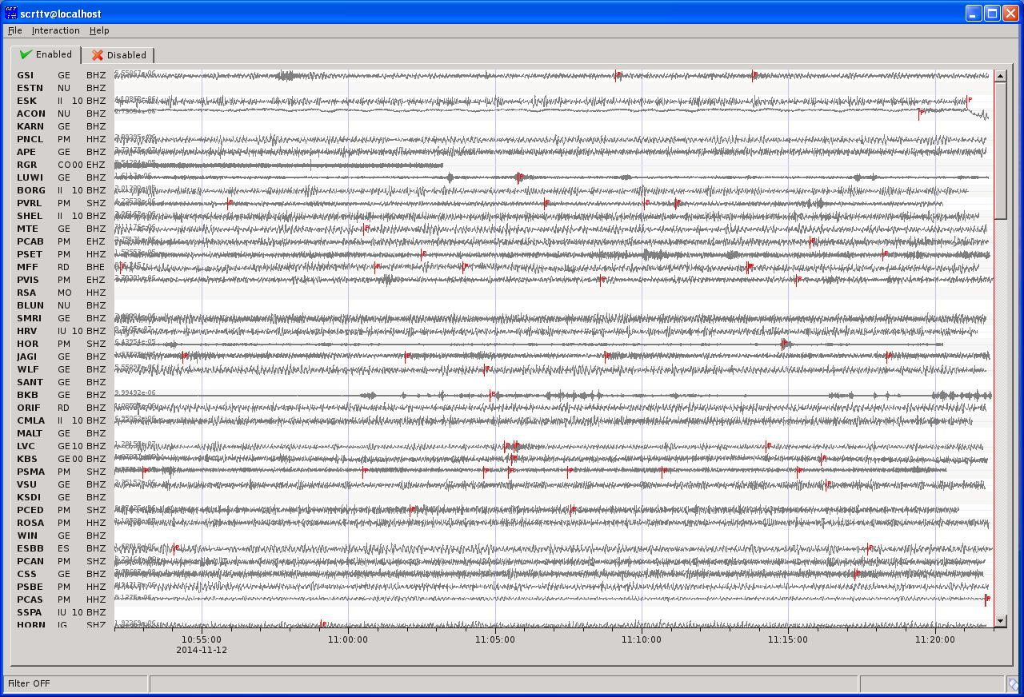
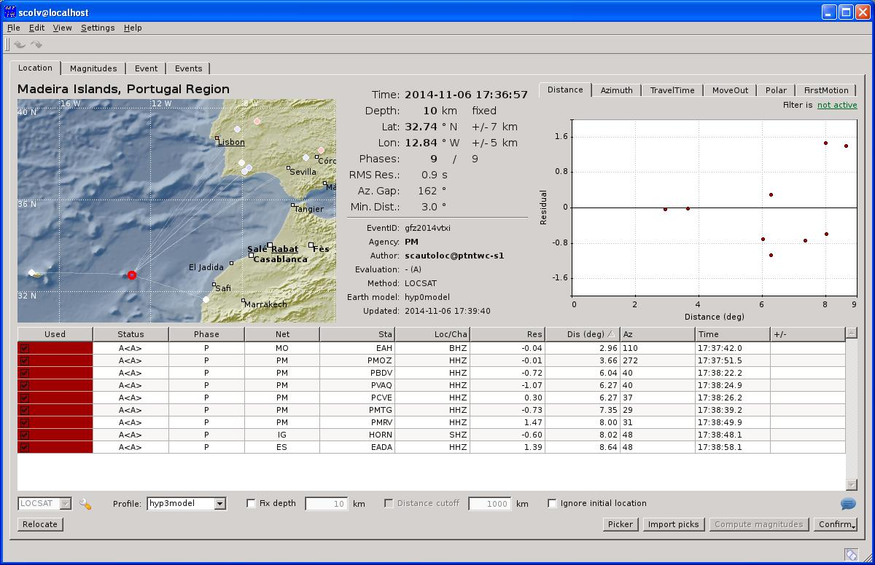
SeiscomP3 – Global Seismic Monitoring
S
Fast locations
MW Fast evaluation

Slide 13
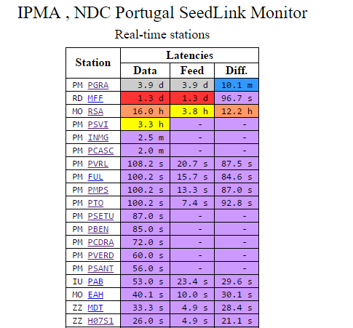
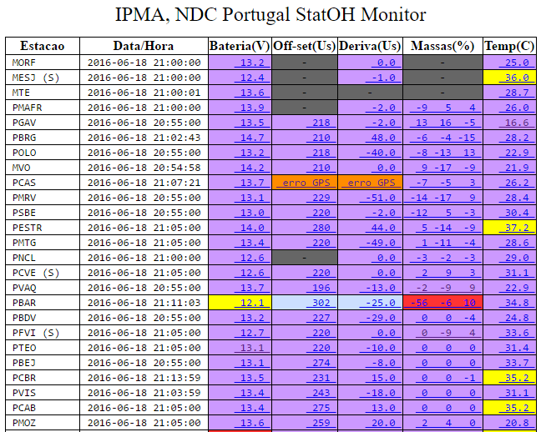
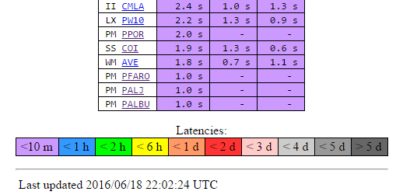
Quality Control
Latency/State of Health

Slide 14
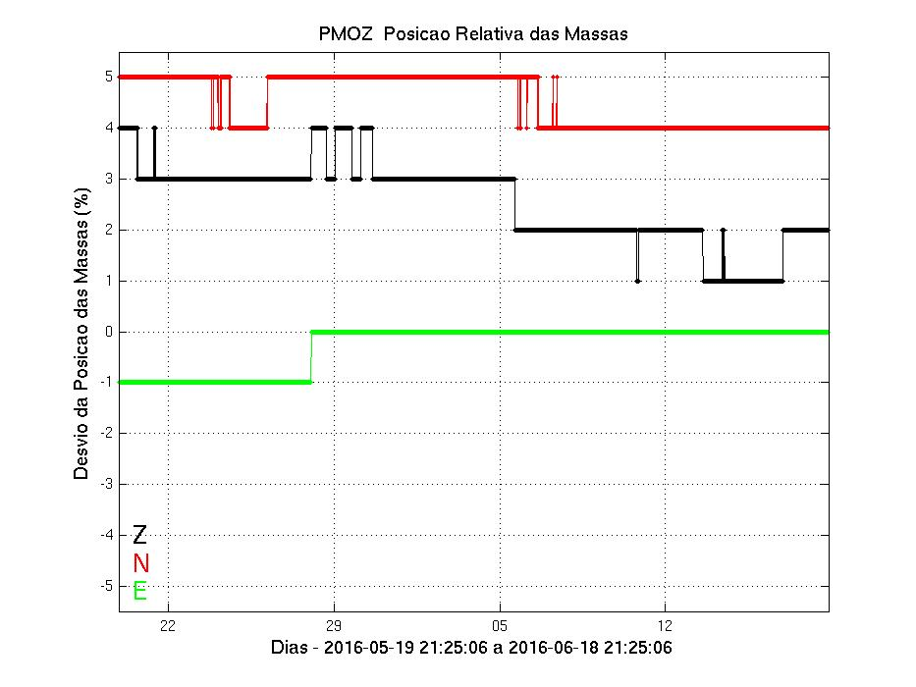
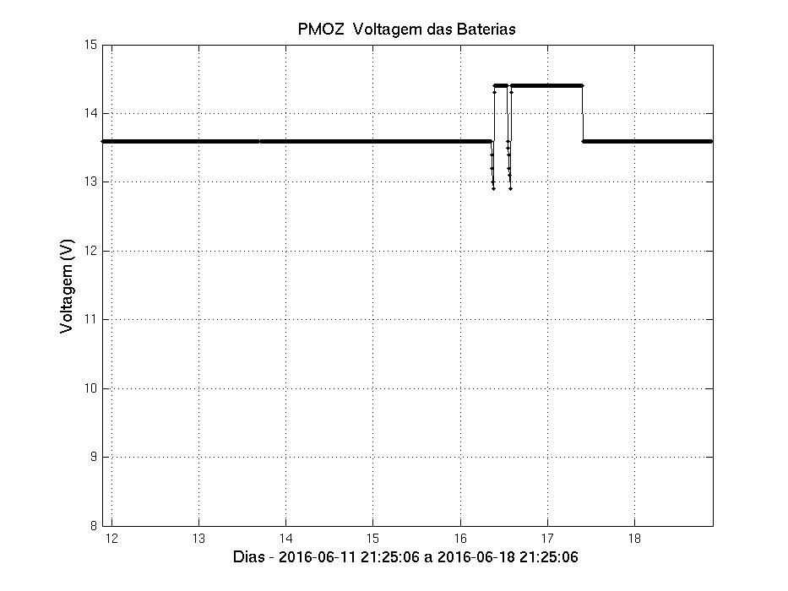
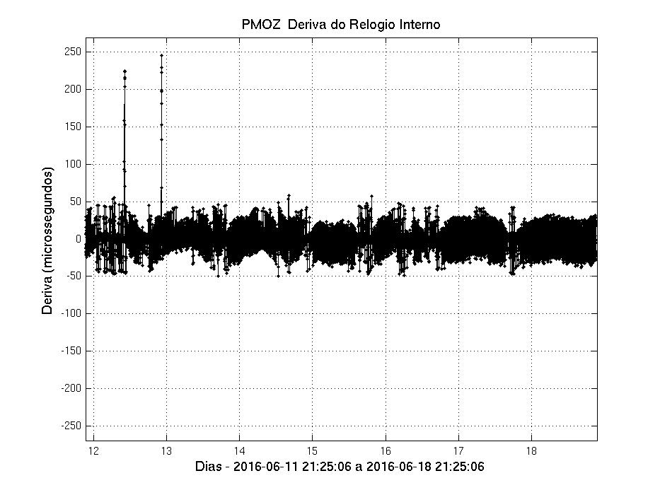
Quality Control
Latency & State of Health

Slide 15
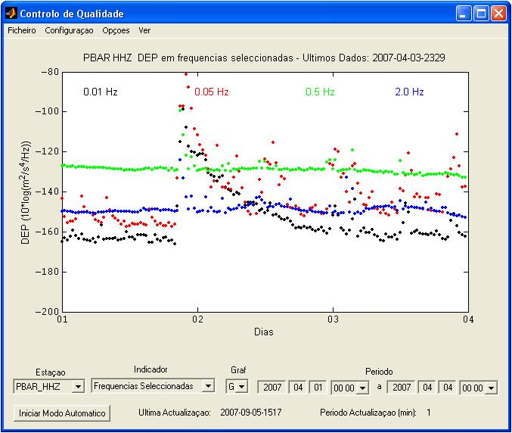
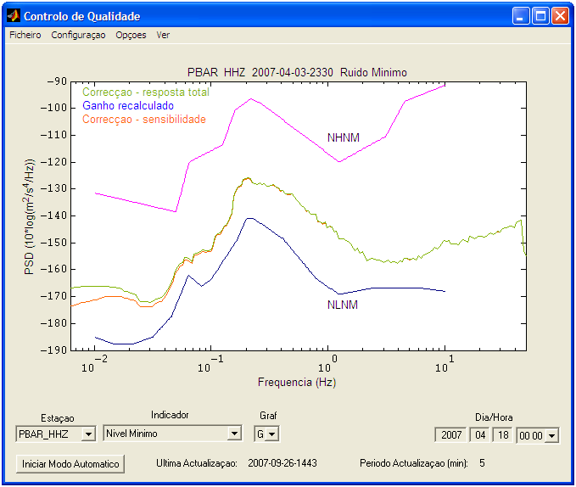
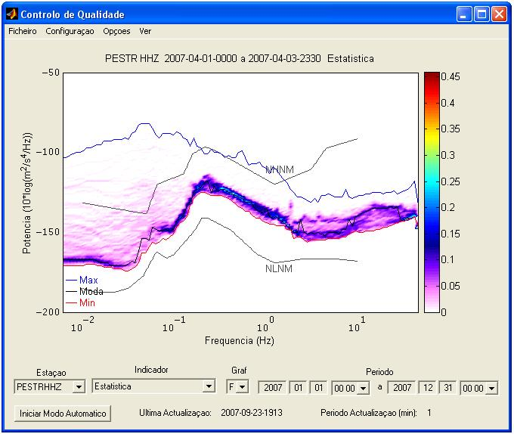
Quality control – Seismic noise

Slide 16
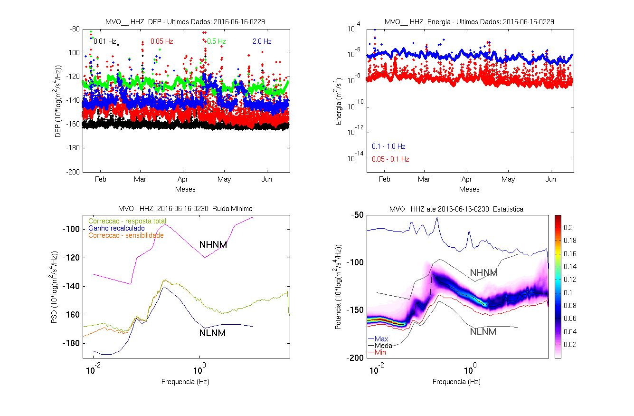
Quality control – Seismic noise

Slide 17
Automatic Detection & Location
Seiscomp3 level
P / PKP /
Amplitudes
Location
(LOCSAT)
&
Magnitudes
ML,Mb,Mw,MB
AutoPick
(SeiscomP3)
STA/LTA
[Single Band Trigger]
Real Time
Waveform
Data
(Event forming)
P Picks Association
P/Pn/Pg/S/Sn/Sg
AML,PGA,PGV
P Picks Association
(event forming)
repicking
Location
(HYPOCENT)
&
Magnitude ML
AutoPic
(SEISAN & InHouse Softw)
STA/LTA
[Multi Band Trigger]
Data_Extract & SEISAN level

Slide 18
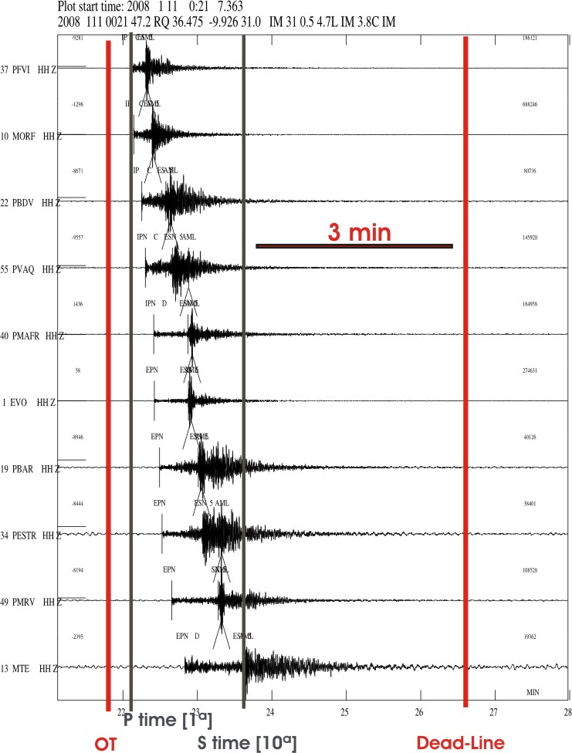
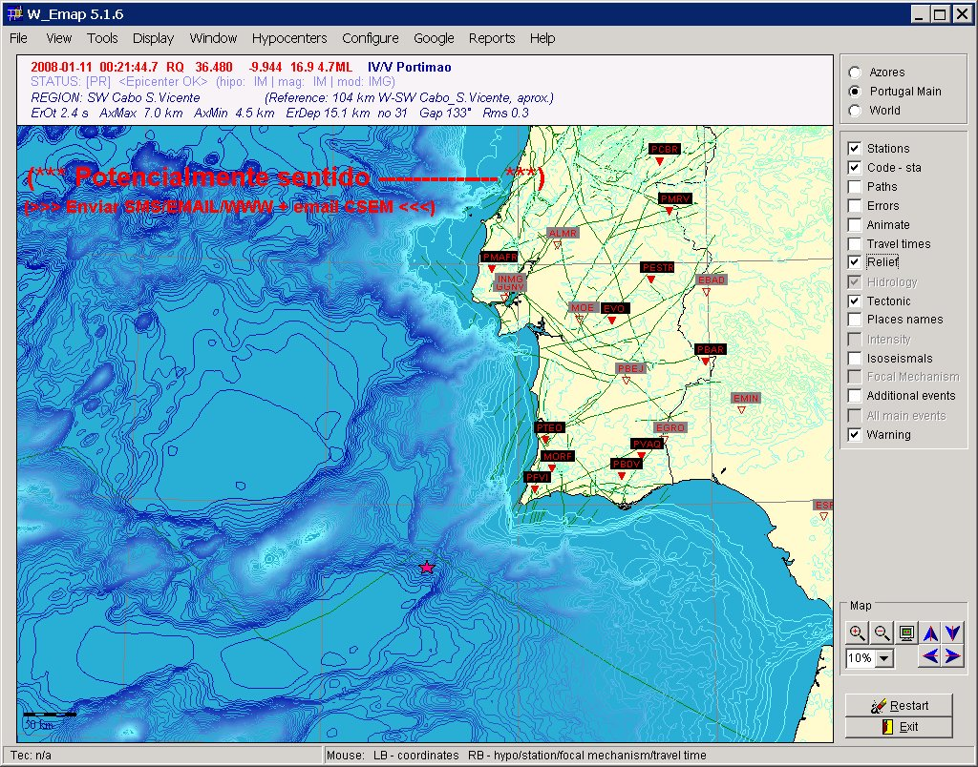
Fast Seismic Warnings
Civil
Protection
Email
SMS
Radio
Fax
Telefone

Slide 19
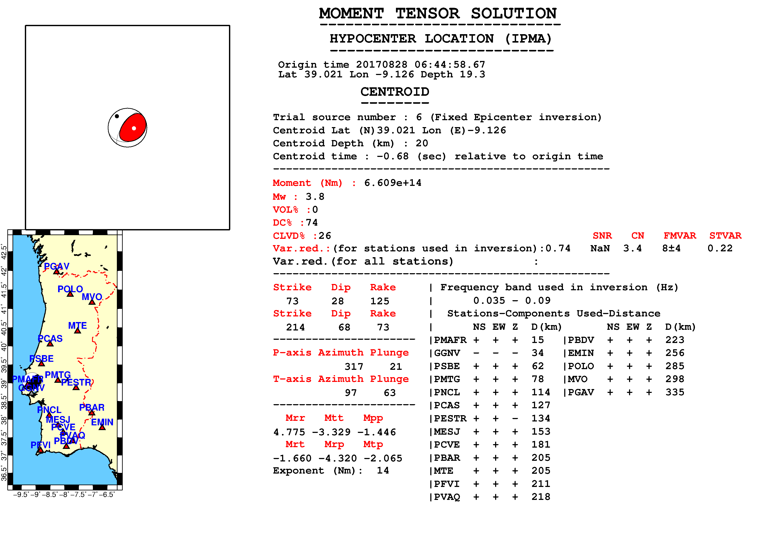
Regional Moment Tensor Inversion

Slide 20
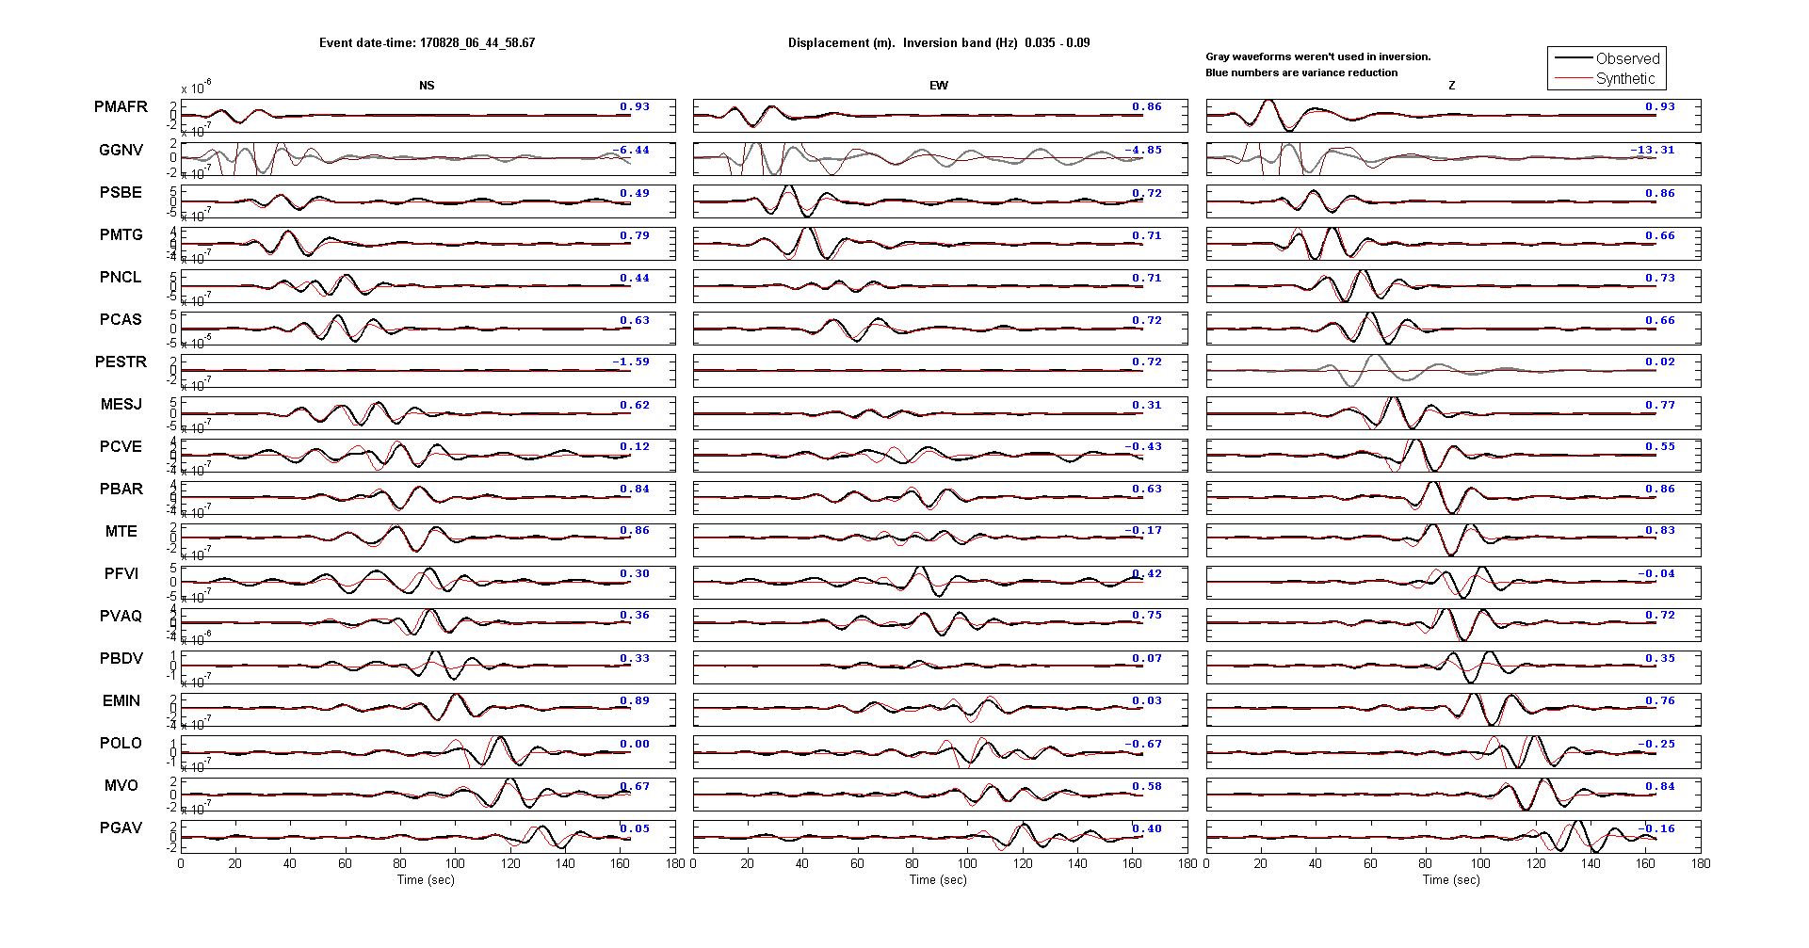
Regional Moment Tensor Inversion

Slide 21
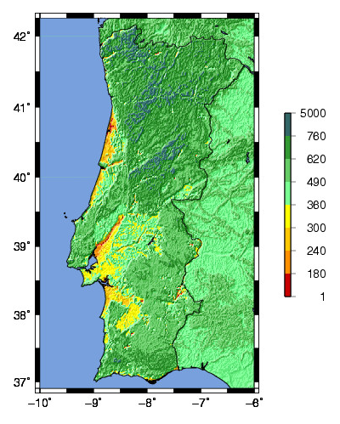
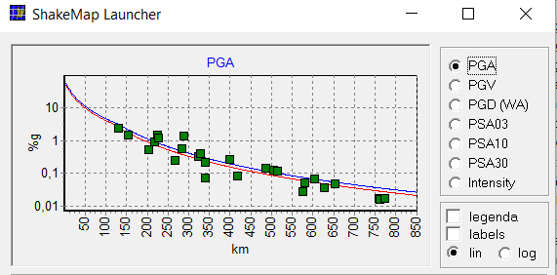
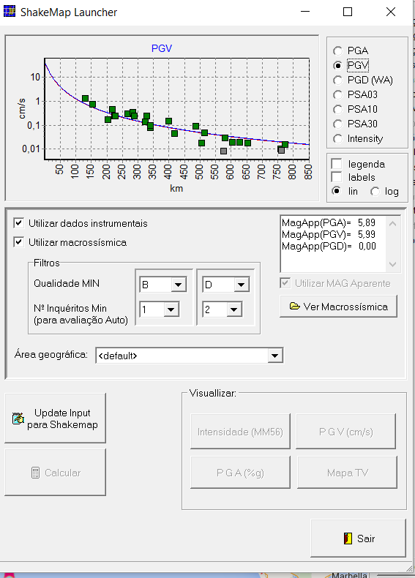
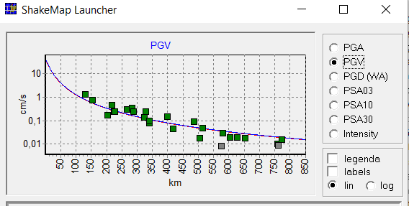
Shakemaps
VS30
Observations and Peak ground attenuation laws

Slide 22
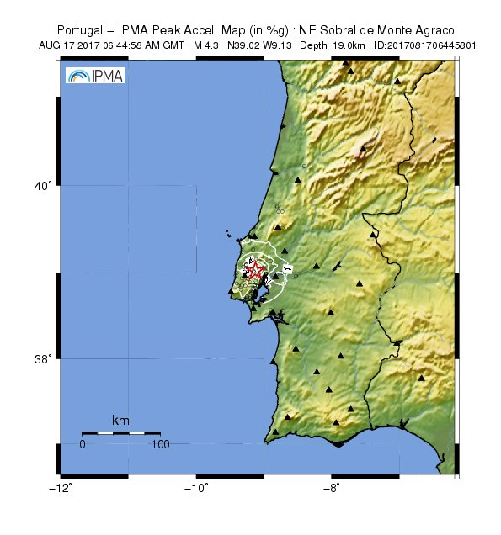
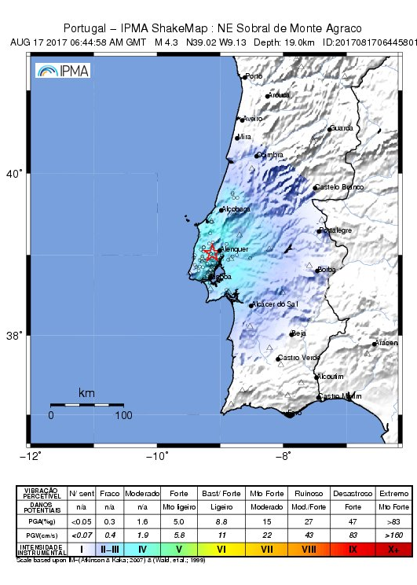
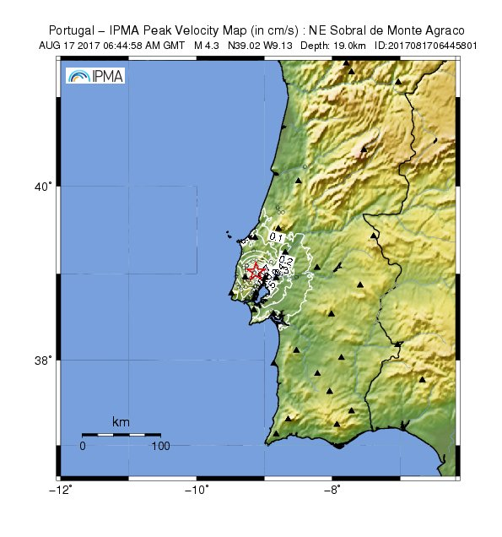
Shakemaps

Slide 23
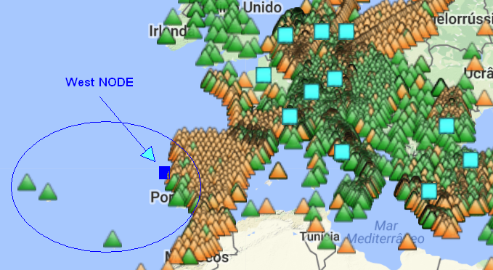
Join EIDA network
Azores, Madeira and PT Mainland region
38 Broadband
24 Short-period
32 Strong-motion
[+ 24 co-located]
(94 stations)

Slide 24
THANK YOU!

