Slide 1
EPOS – ORFEUS Seismology Workshop
Seismic Infrastructure in Spain:
Catalunya’s network

Slide 2
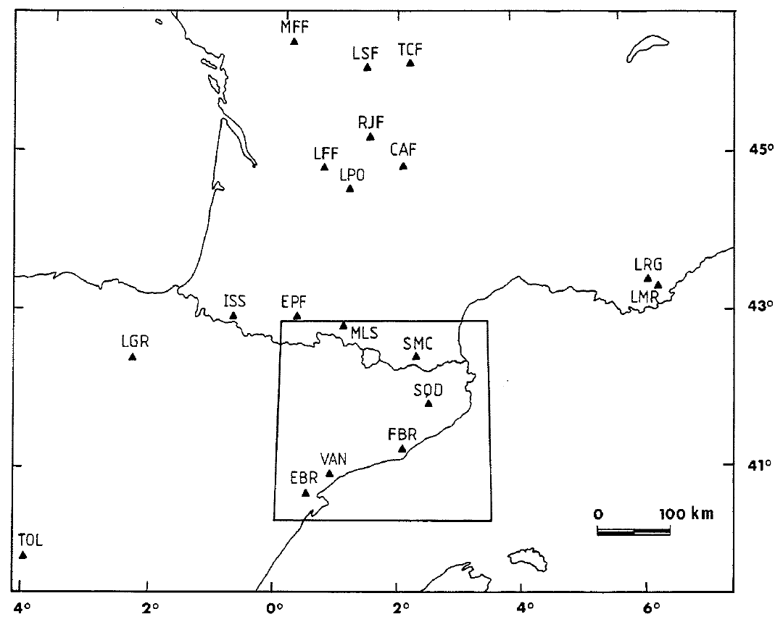
Catalan seismic network
2
1984

Slide 3
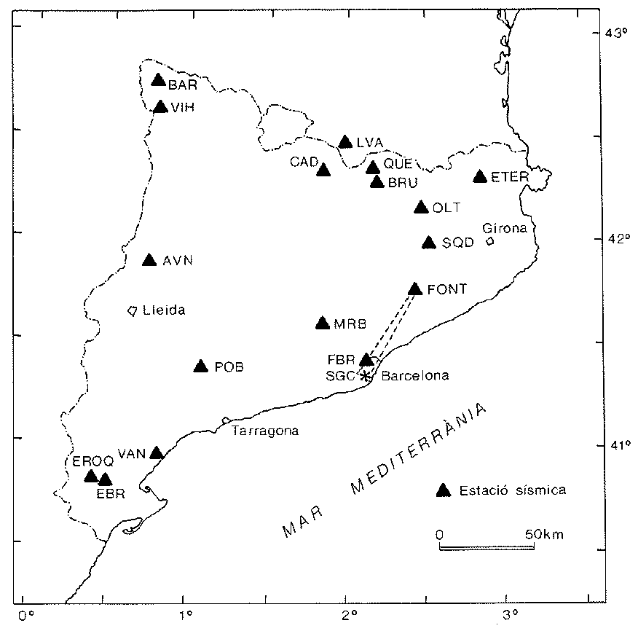
Catalan seismic network
3
1984
1989

Slide 4
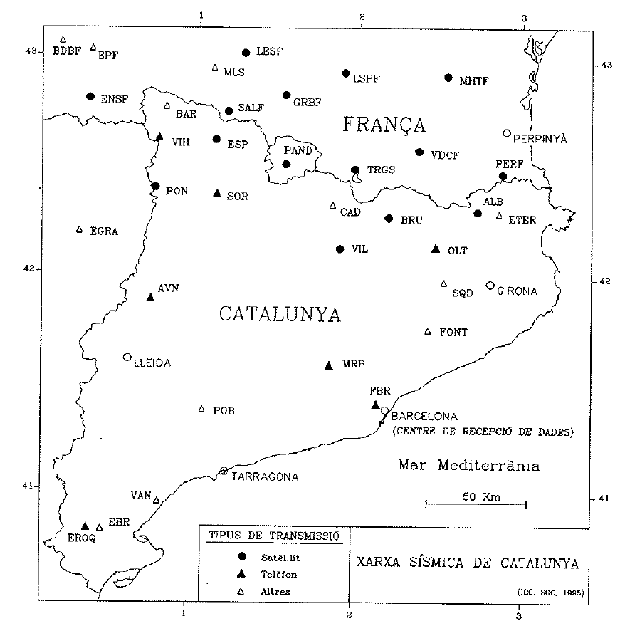
Catalan seismic network
4
1984
1989
1994

Slide 5
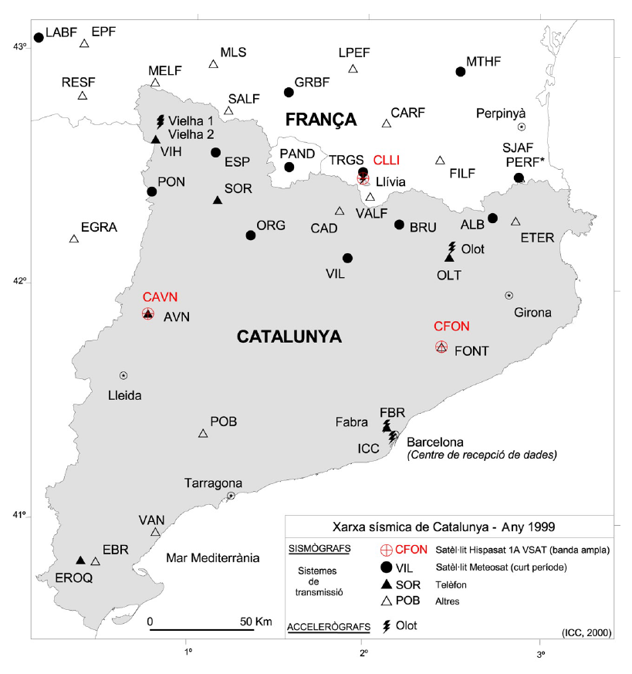
Catalan seismic network
5
1984
1989
1994
1999

Slide 6
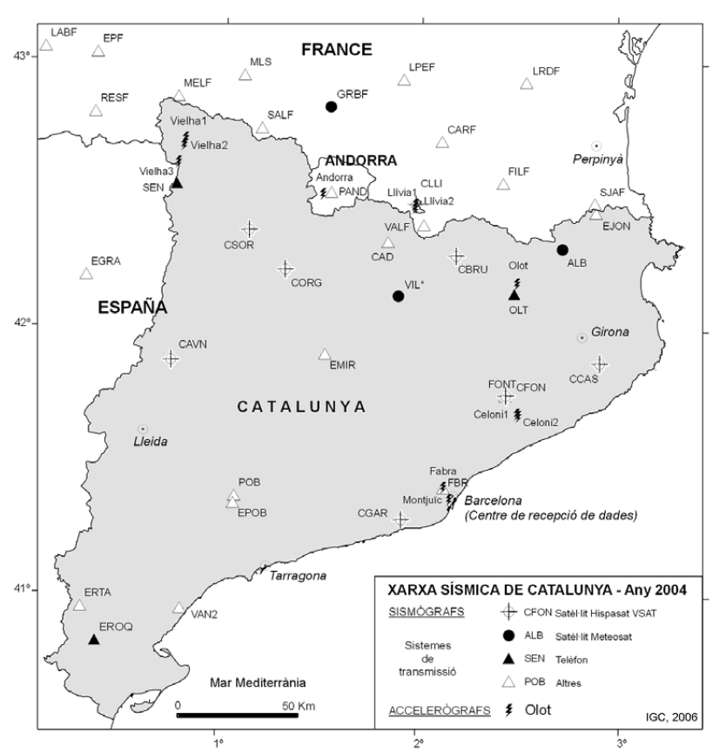
Catalan seismic network
6
1984
1989
1994
1999
2004

Slide 7
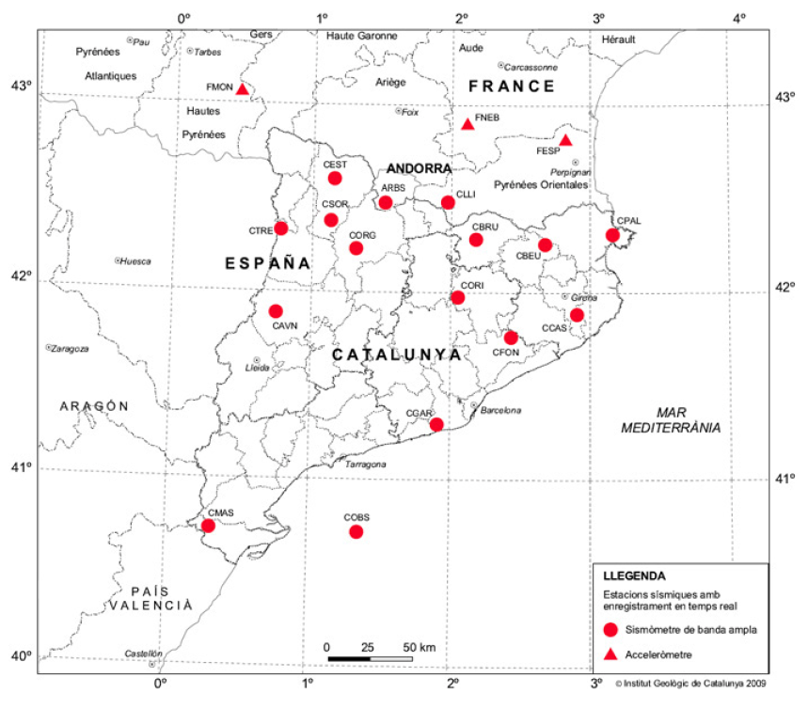
Catalan seismic network
7
1984
1989
1994
1999
2004
2009

Slide 8
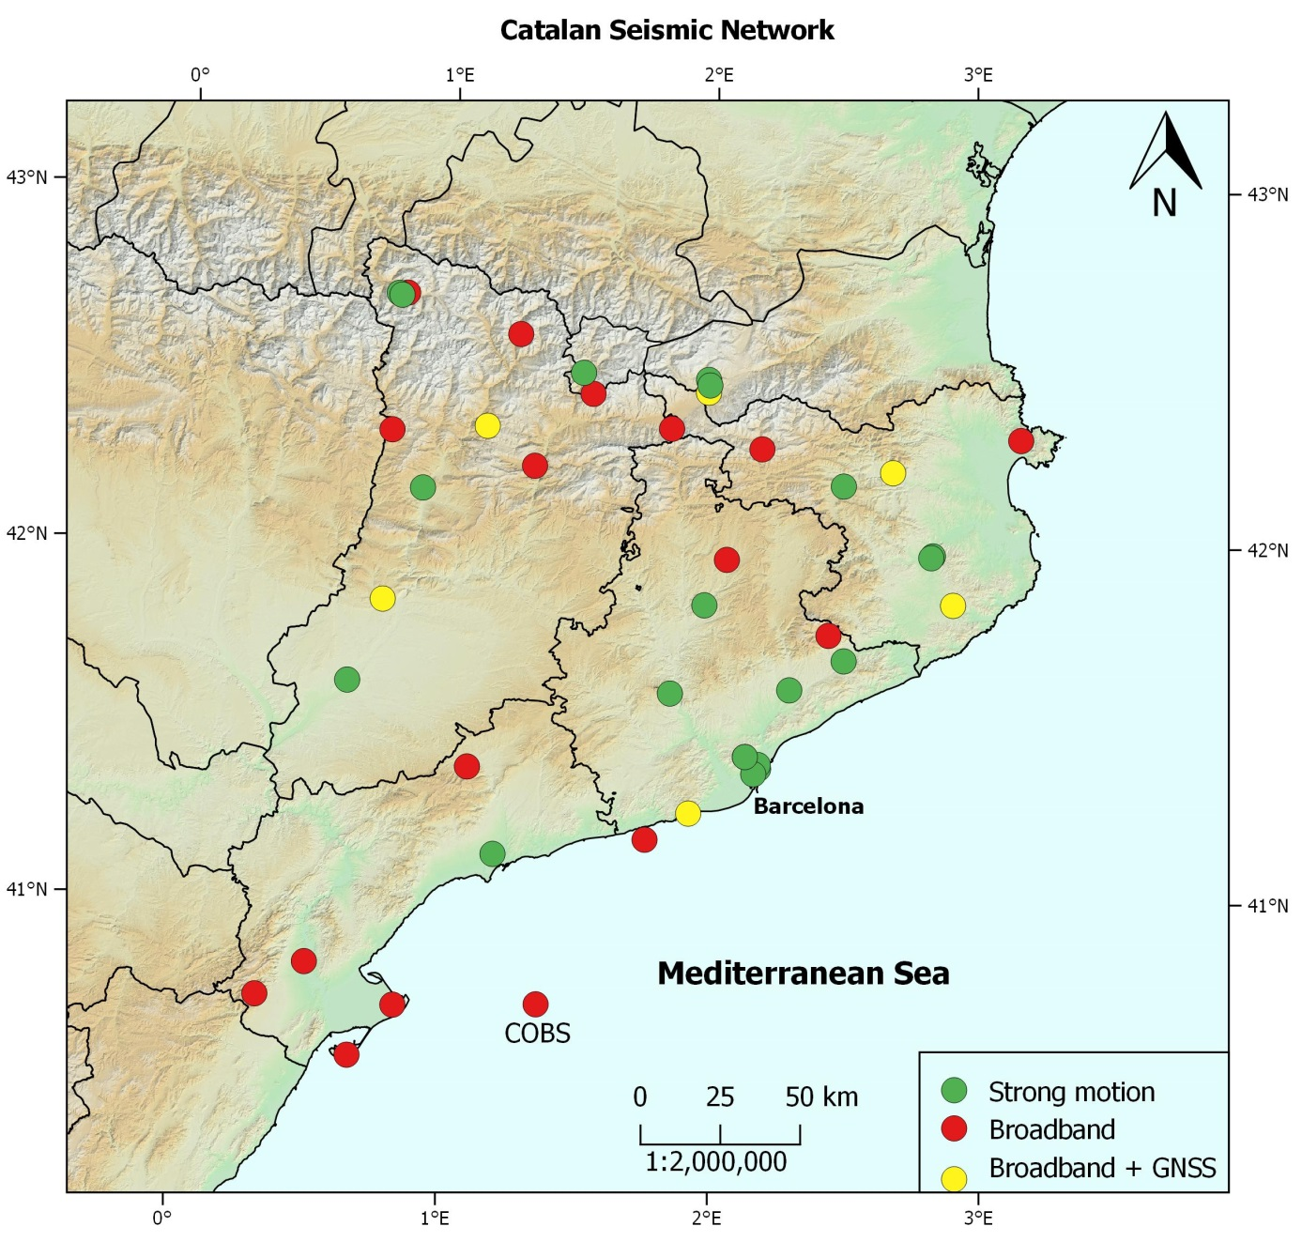

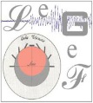




Catalan seismic network
8
http://www.icgc.cat/en/xarxasismica
Citation:
Catalan Seismic Network. International Federation of Digital Seismograph Networks. Other/Seismic Network: doi: 10.7914/SN/CA.

Slide 9

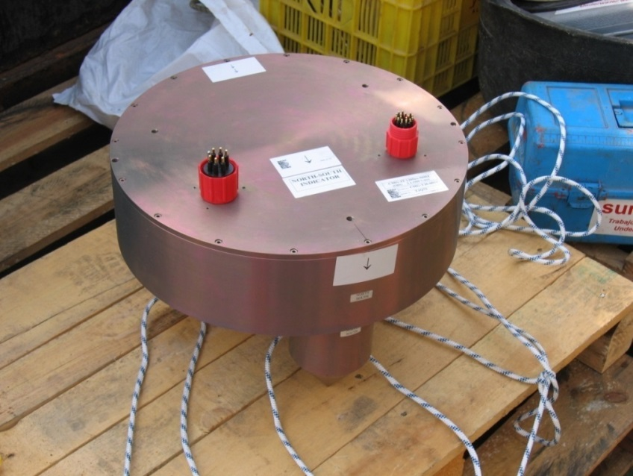
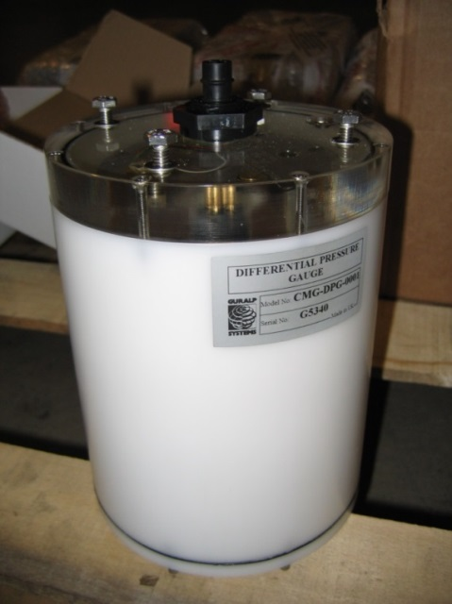
Catalan seismic network
9
Permanent cabled OBS installed in 2005 in collaboration with Repsol and Ebre Observatory.
- Continuous real-time data transmission (VSAT).
- Damaged early 2015 and now on process of purchasing a new instrument to replace it.

Slide 10
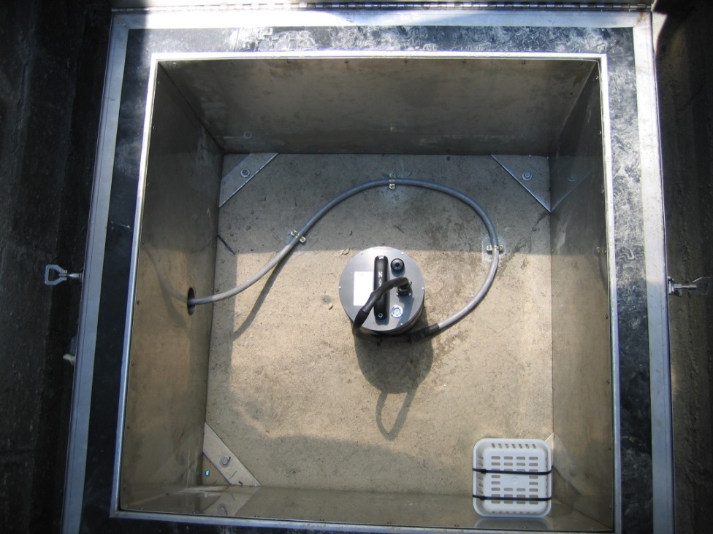
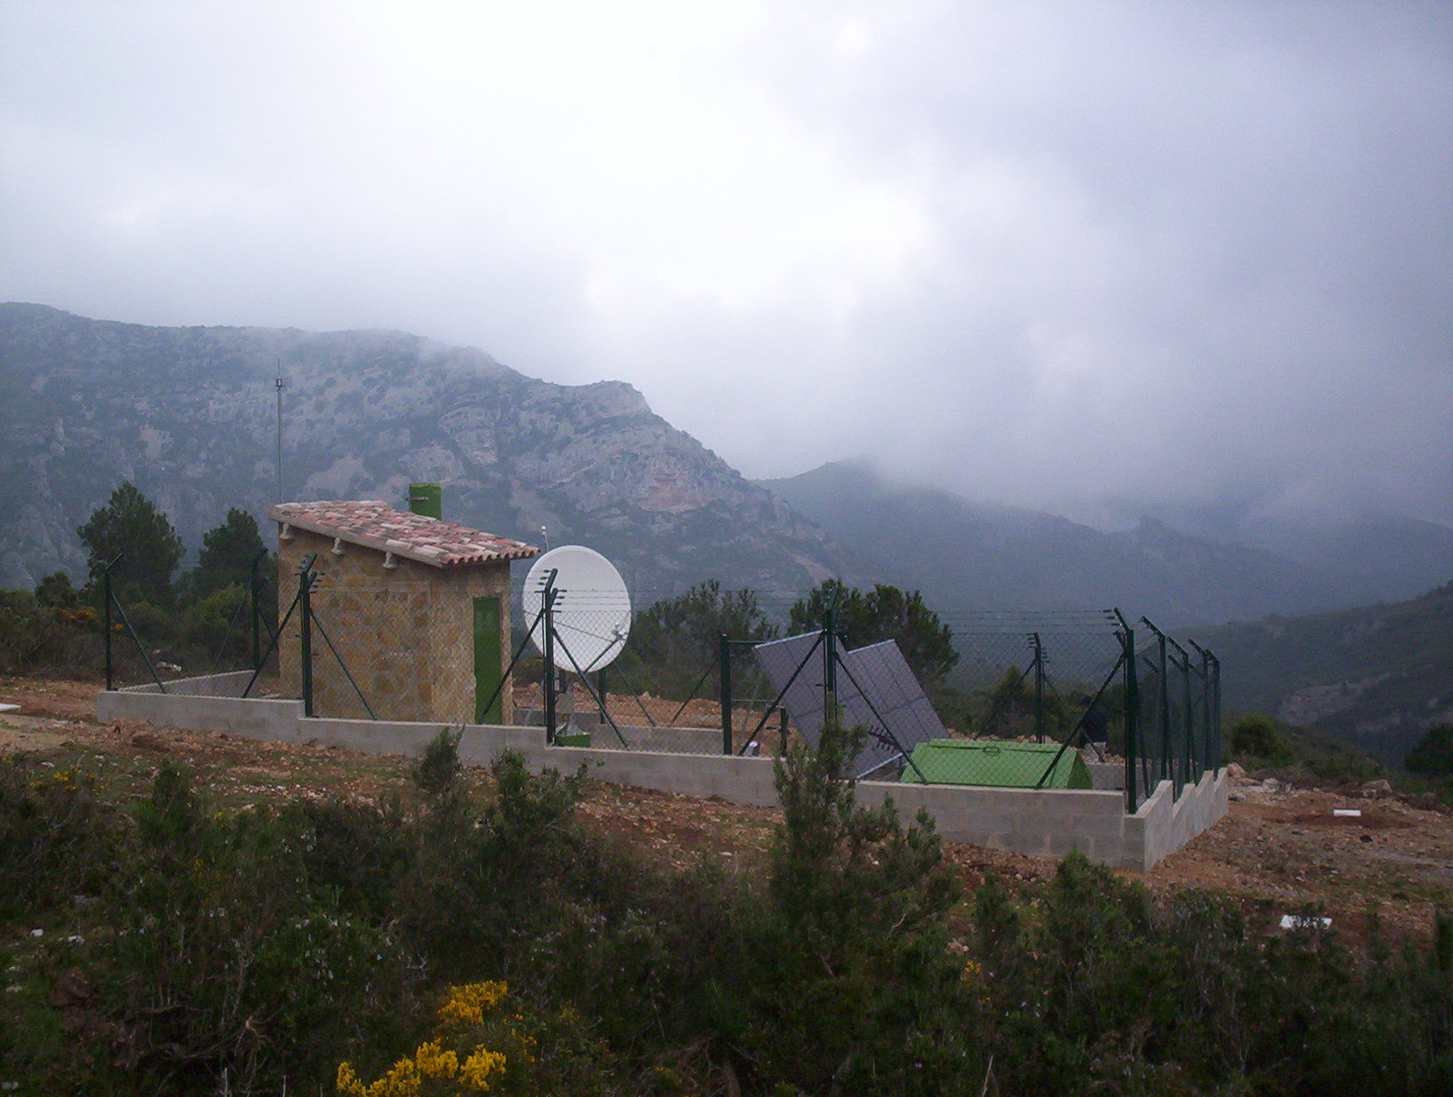
Catalan seismic network
10

Slide 11
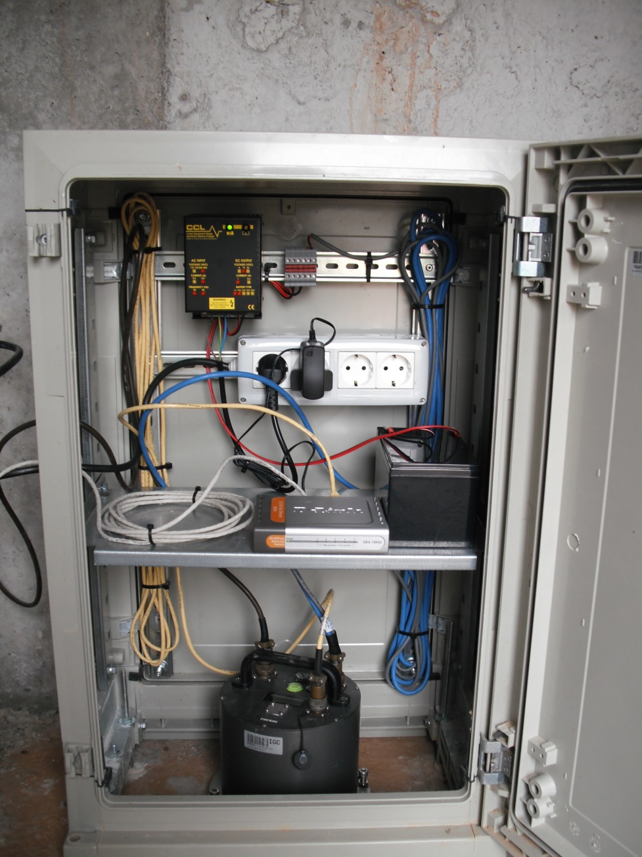
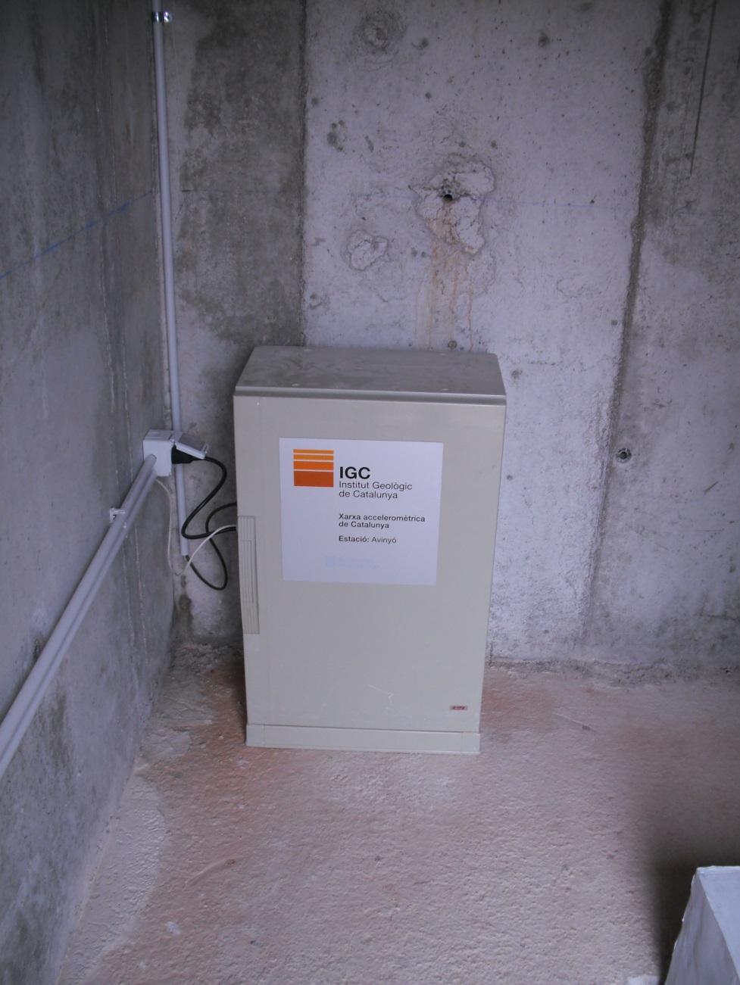
Catalan seismic network
11

Slide 12
Catalan seismic network
12
  Next steps:
  Two new BB stations in the south of Catalonia (2018-2019).
  Update the oldest BB sensors (2018).
  Replace equipment of COBS station.
  Updating digitizers and communication systems (VSAT) (2018).
  Densifying the strong motion network in collaboration with IGN (2018-2019).

Slide 13
Catalan seismic network
13
  Data accessibility
  Web sites of network partners
  ICGC website: http://www.icgc.cat/en/xarxasismica
    Stations metadata
    Live data
    Events data
    Shakemaps
    …

Slide 14
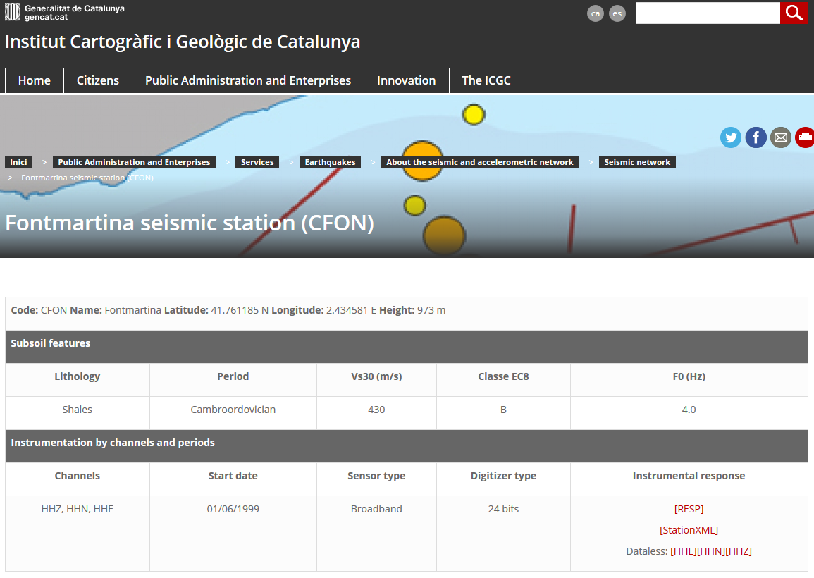
Catalan seismic network
14
  Data accessibility: ICGC website
  Stations metadata
http://www.icgc.cat/en/xarxasismica

Slide 15
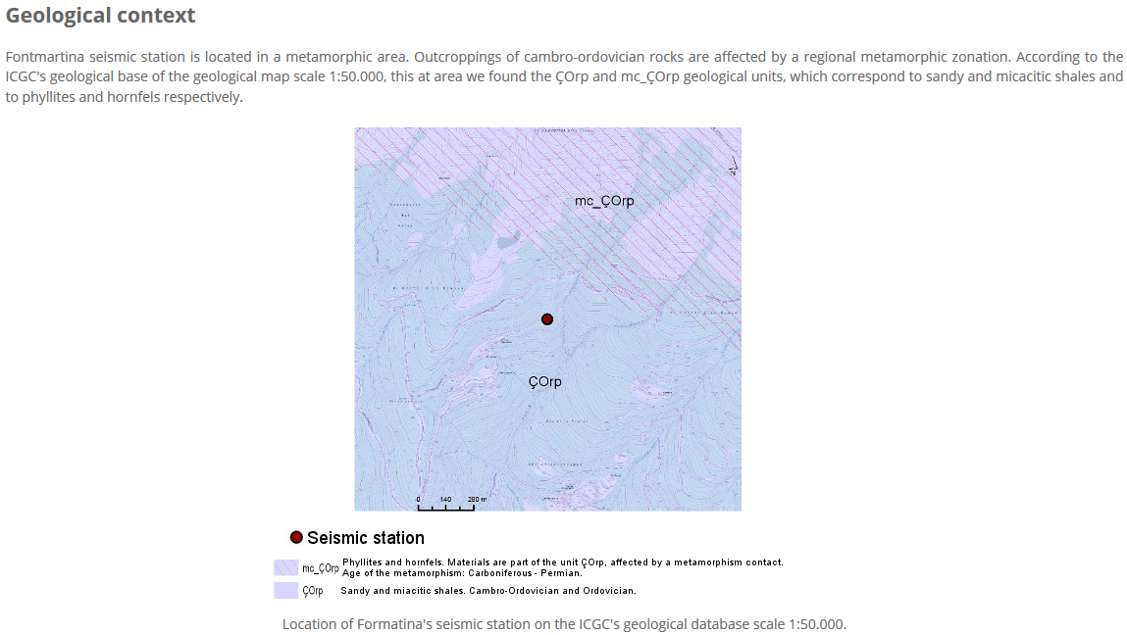
Catalan seismic network
15
http://www.icgc.cat/en/xarxasismica

Slide 16
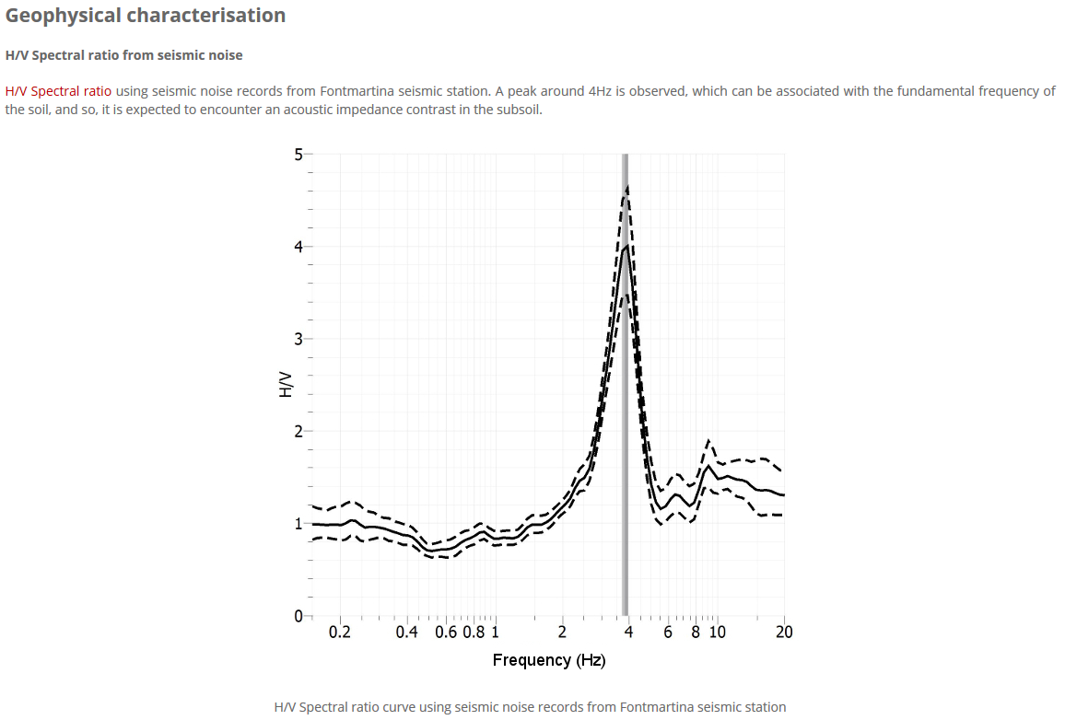
Catalan seismic network
16
http://www.icgc.cat/en/xarxasismica

Slide 17
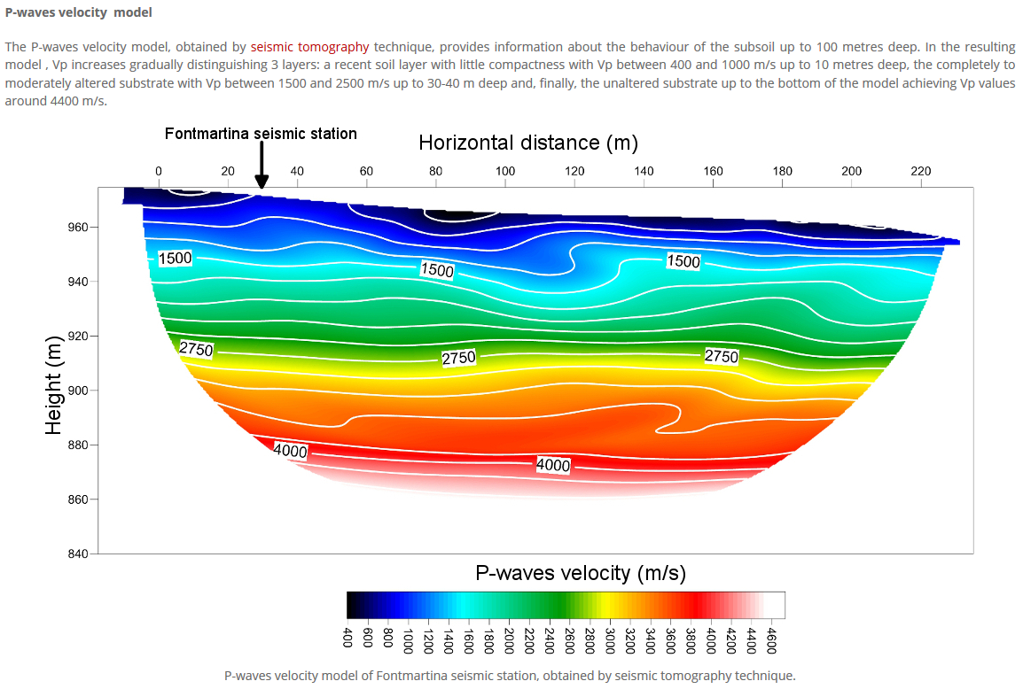
Catalan seismic network
17
http://www.icgc.cat/en/xarxasismica

Slide 18
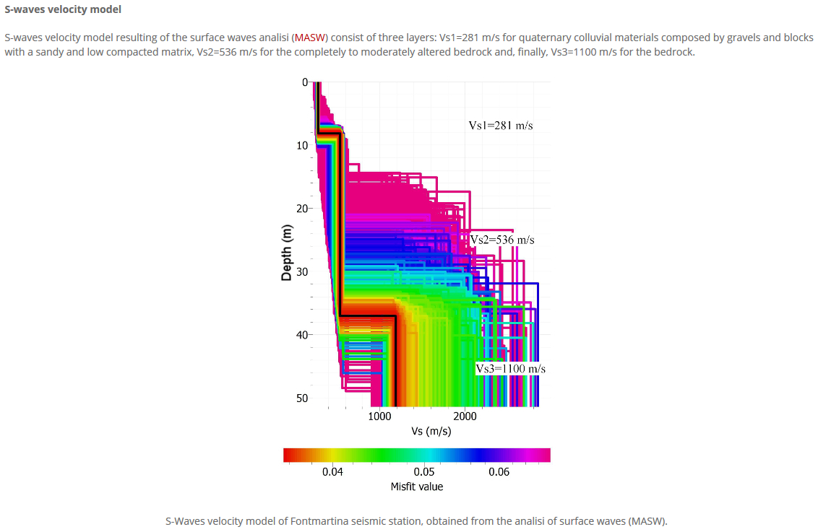
Catalan seismic network
18
http://www.icgc.cat/en/xarxasismica

Slide 19
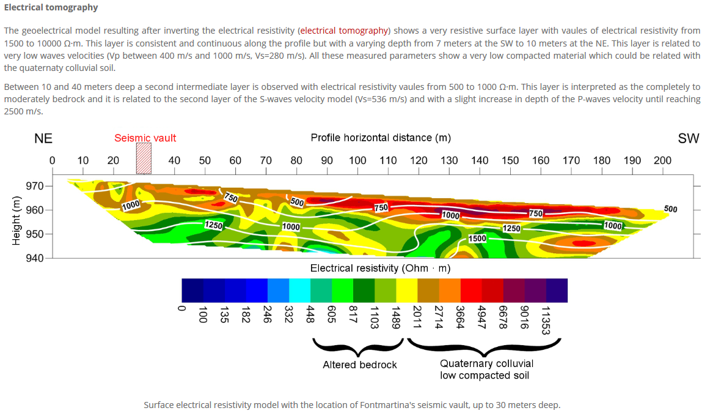
Catalan seismic network
19
http://www.icgc.cat/en/xarxasismica

Slide 20
Catalan seismic network
20
  Data accessibility
  ICGC Datacenter archives waveforms from stations of the Catalan Seismic Network and provides free of charge and open access to them.
  FDSNWS: ws.icgc.cat
    Real-time waveforms by SeedLink
    http://ws.icgc.cat:18000
    Stations metadata (fdsnws-station)
    http://ws.icgc.cat/fdsnws/station/1/version
    Stations metadata (fdsnws-dataselect)
    http://ws.icgc.cat/fdsnws/dataselect/1/version

Slide 21
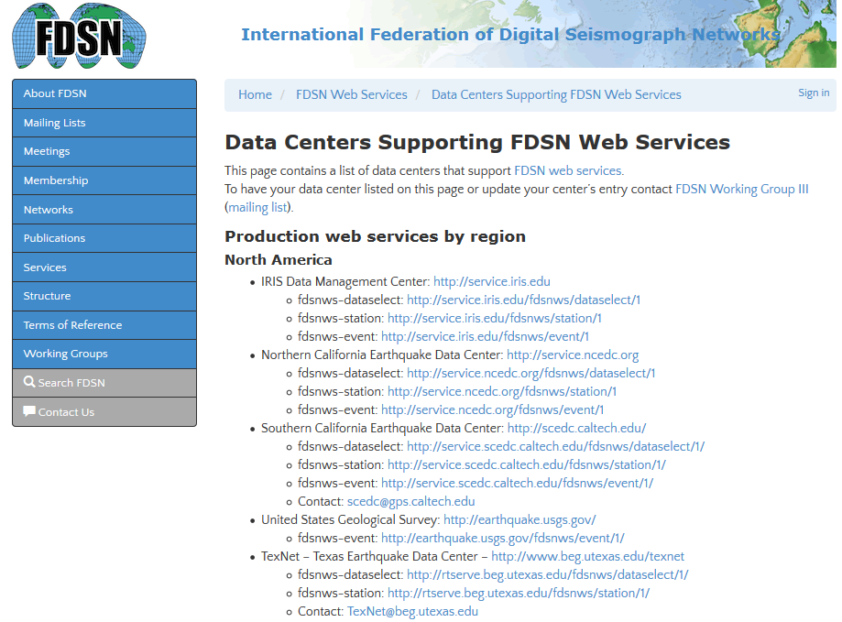
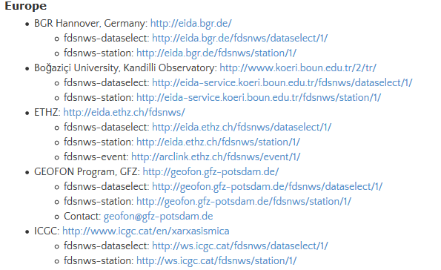
Catalan seismic network
21

Slide 22
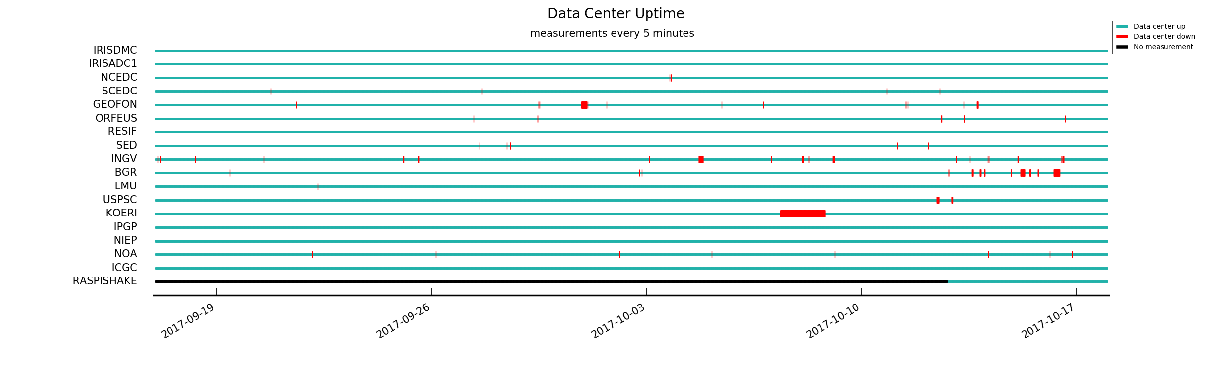
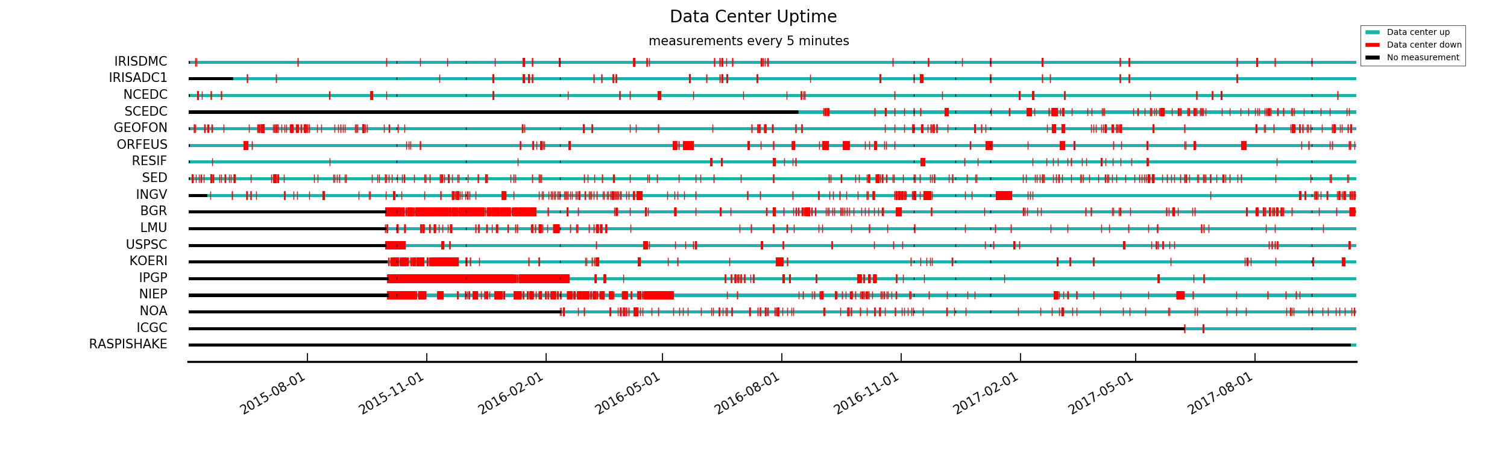
Catalan seismic network
22
Last 31 days
All time
Source: IRIS DMC Data Center Measurement Stats (http://ds.iris.edu/files/stats/datacenters/)

Slide 23
Catalan seismic network
23
Thanks!

