Slide 1
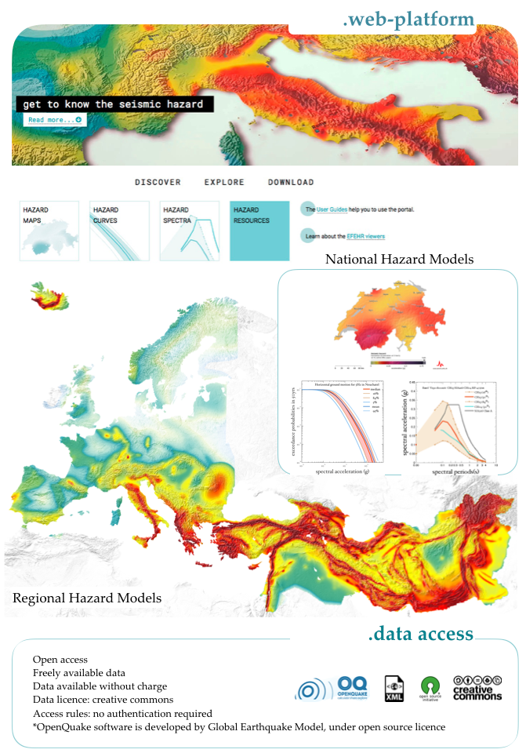
European Facilities for Earthquake Hazard and Risk (EFEHR): status of the main services
L.Danciu | Swiss Seismological Service | ETH Zurich
Switzerland
contributors:
S.Wiemer, F. Haslinger, P. Kastli,
R. Basili, F. Cotton, K. Pitsilakis,
H. Crowley, E. Safak

Slide 2
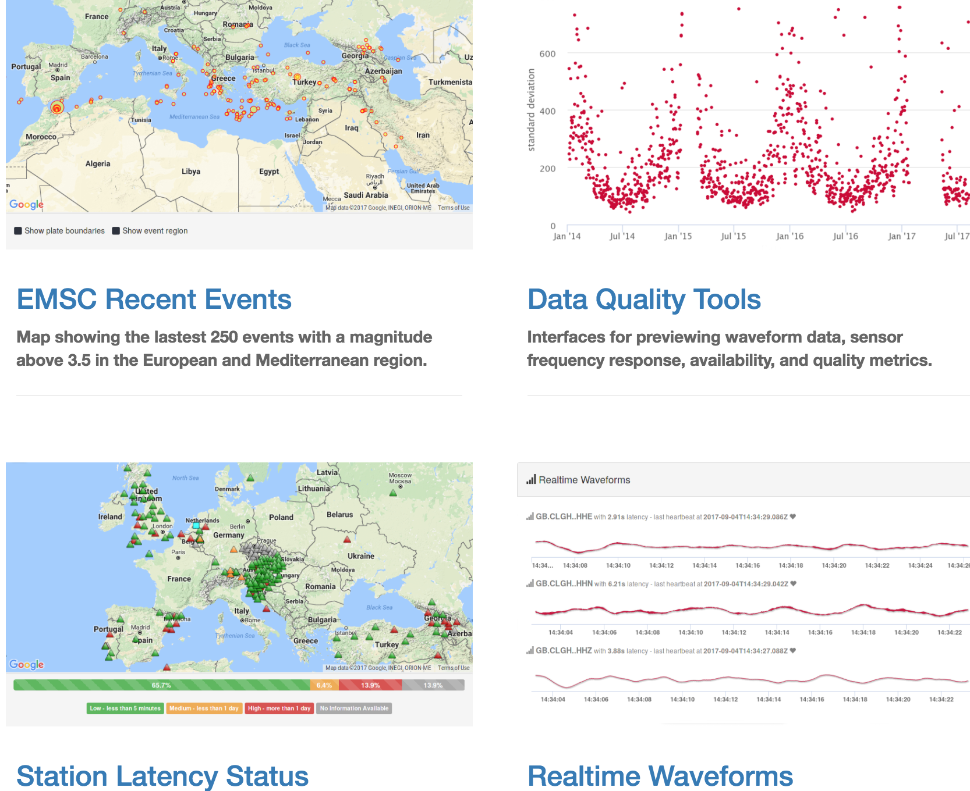
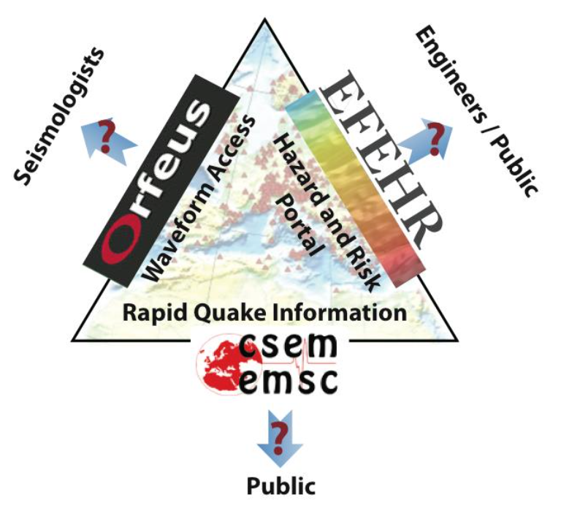
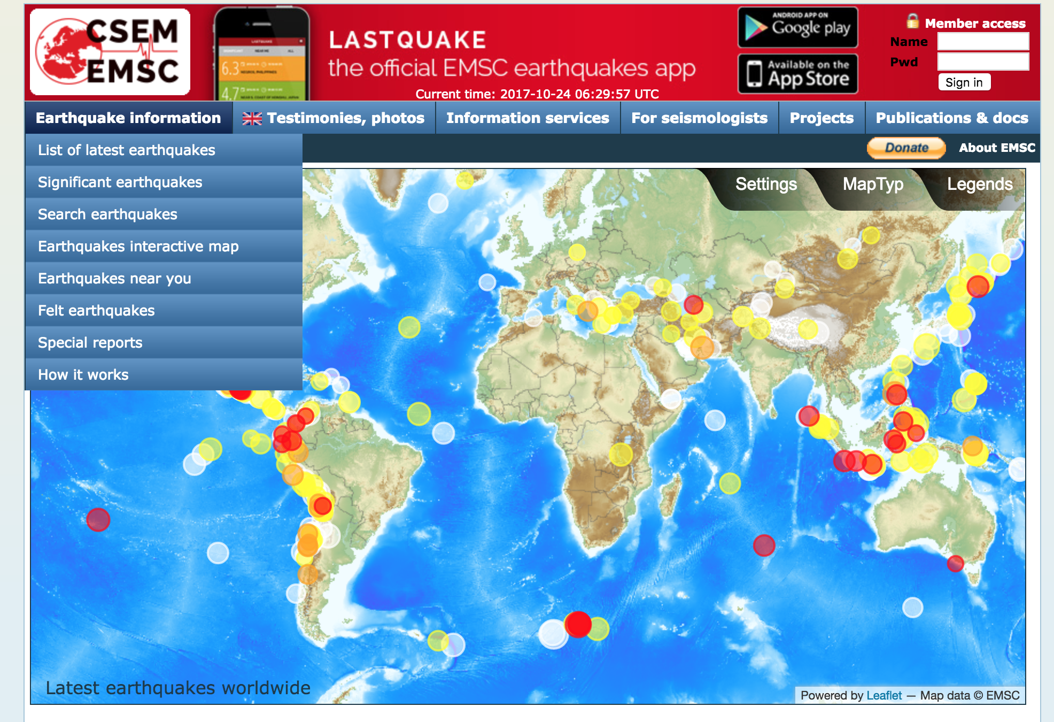
.about EFEHR
seismology
European Facilities for Earthquake Hazard and Risk
Waveform Services
Waveform selection & access
Waveform metrics & Station Information Strong Motion parameters
OBS data integration
Mobile Pool coordination & integration
Seismic Hazard Results | Seismogenic Source Models | Active Faults
Earthquake Catalogues | Exposure and Vulnerability | Earthquake Risk Models
Access to Hazard and Risk Calculation
Earthquake Parameter Information | Macroseismic & Historical Event data Seismological Products | Platform - rupture models / SiteCharTool / MT - EventID / F-E-Region
Notes:
EFEHR forms the hazard and risk pillar of the Thematic Core Services (TCS) for Seismology in the European Plate Observing System (EPOS).

Slide 3
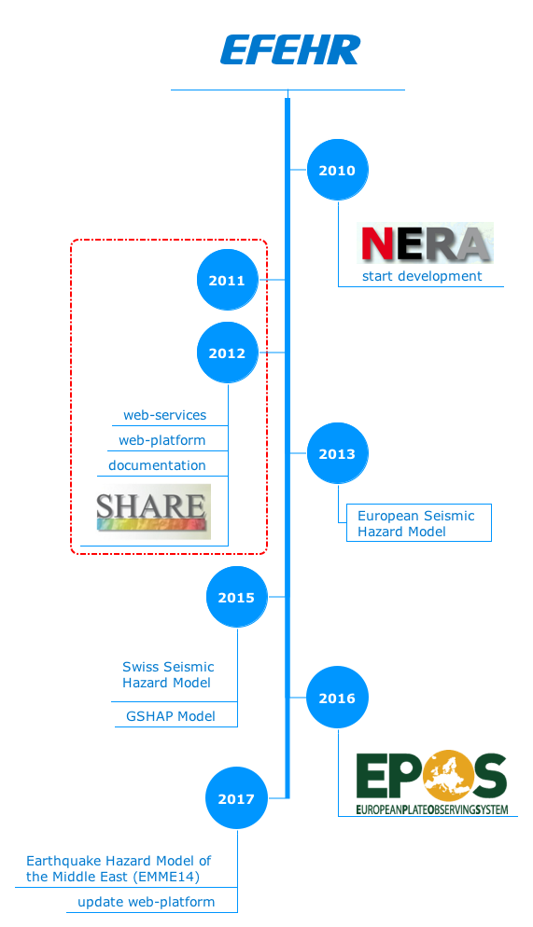
.introducing EFEHR
seismology
European Facilities for Earthquake Hazard and Risk (EFEHR, www.efehr.org) established in 2010, provide coordinated services for earthquake hazard and risk information for Euro-Mediterranean region.
Initially developed within the EU FP7 projects NERA (2010-2014), SYNER-G (2009-2012) and SHARE (2010-2013).

Slide 4
.organisational
Host Institution - EFEHR is hosted by Swiss Seismological Service, ETH Zurich since 2010
Staff: operated currently by: L. Danciu (Models Support, Data Service, Executive), P.Kastli (IT Service and Support), Developers (E. Petronio, C. Bonjour), M. Marti (Communication), S. Wiemer (Executive), F. Haslinger (Executive, EPOS integration)

Slide 5
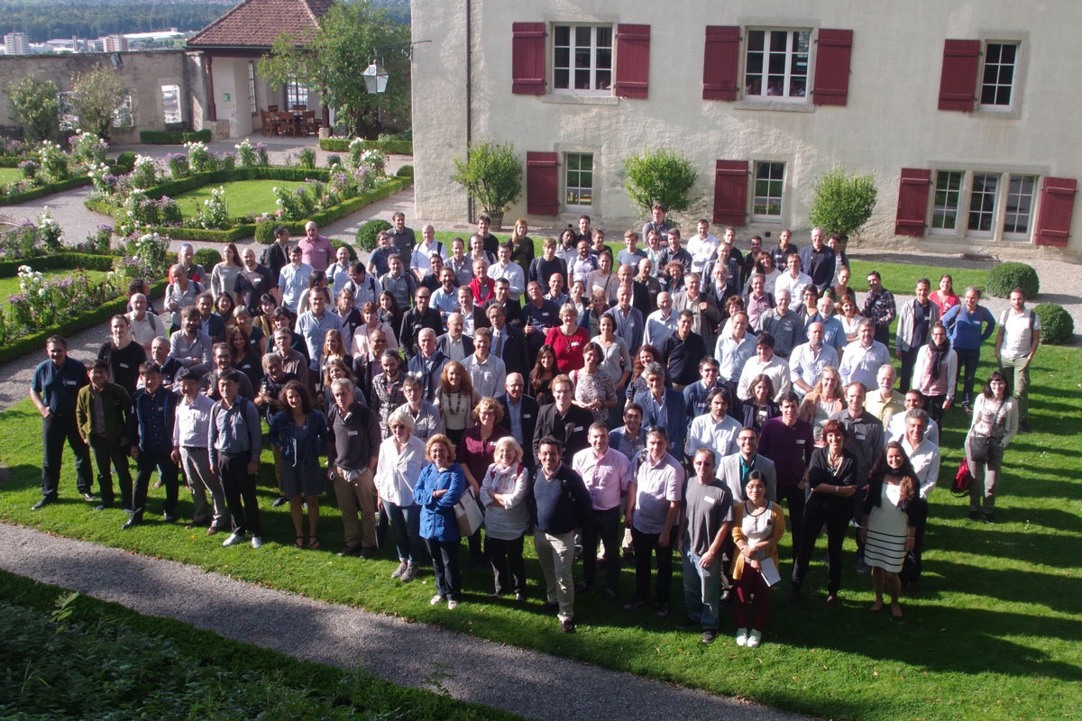
First Meeting on EFEHR governance
Workshop in Lenzburg (5-8th September, 2017 )
the state-of-the art and best practice of seismic hazard
165 participants (world-wide)
National hazard modelers and stakeholders
20 key-note speakers

Slide 6
EFEHR. services
Notes:
EFEHR will integrate at a technical and scientifically level with five other specialised nodes that provides data and products:

Slide 7
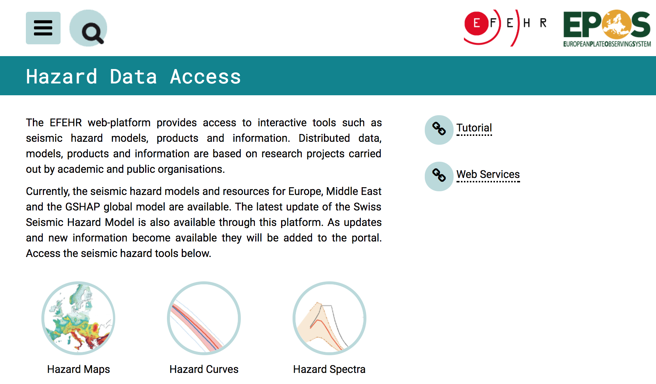
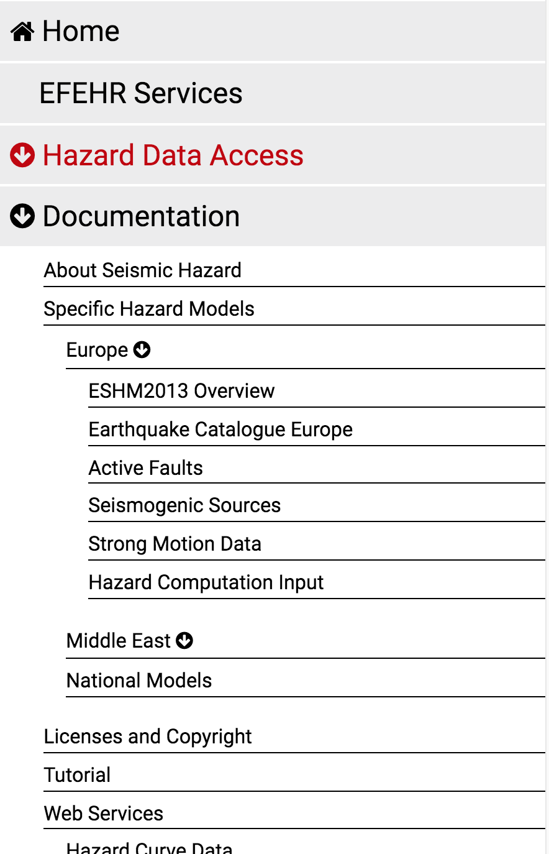
Hazard Platform
(operational)
www.efehr.org
Notes:
Enable national and local hazard and risk assessment by providing access to the software, data, models and expertise requited for contemporary hazard and risk assessment.
Maintain, review and enhance collections of seismogenic source models, harmonised datasets (earthquake catalogues, active faults) for assessment of seismic hazard, collection of national hazard models for Europe.

Slide 8
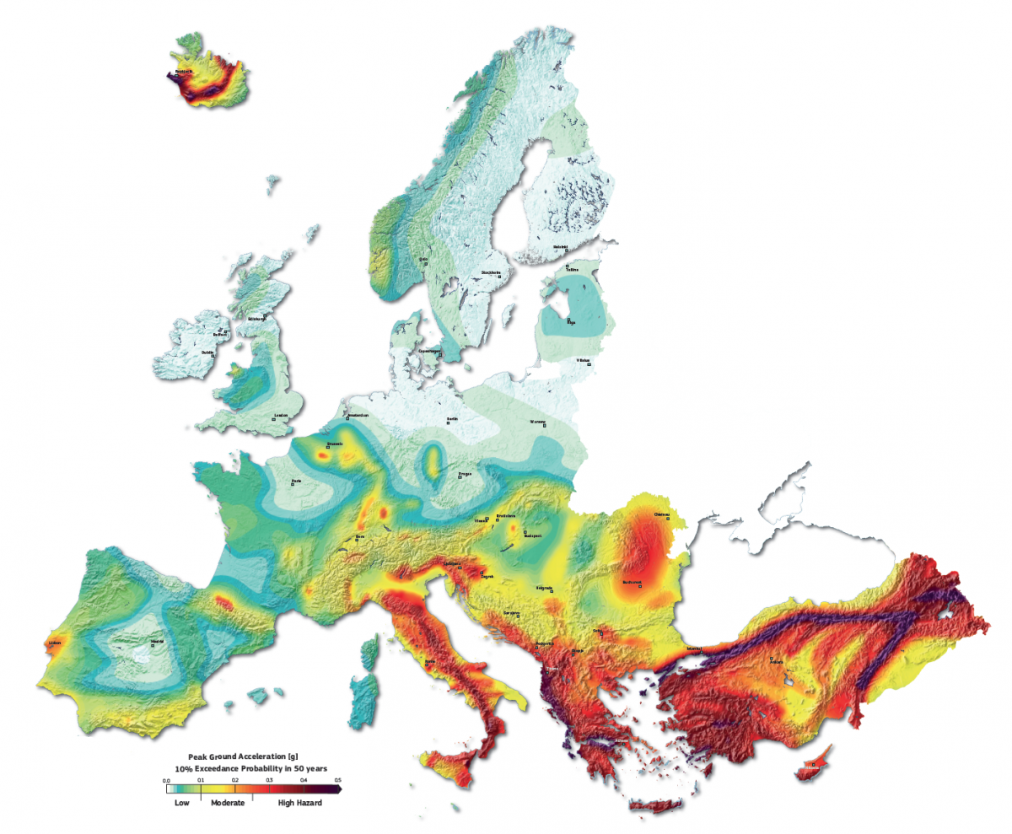
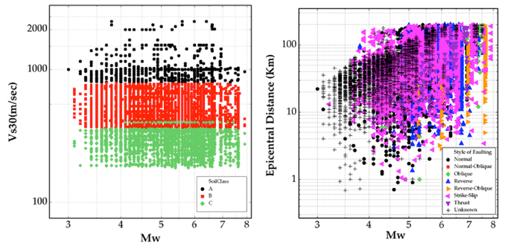
EFEHR.features
Discover, Access, Explore, Download - Hazard Results
Maintain, Review, Enhance - Harmonised Data Models
www.efehr.org

Slide 9
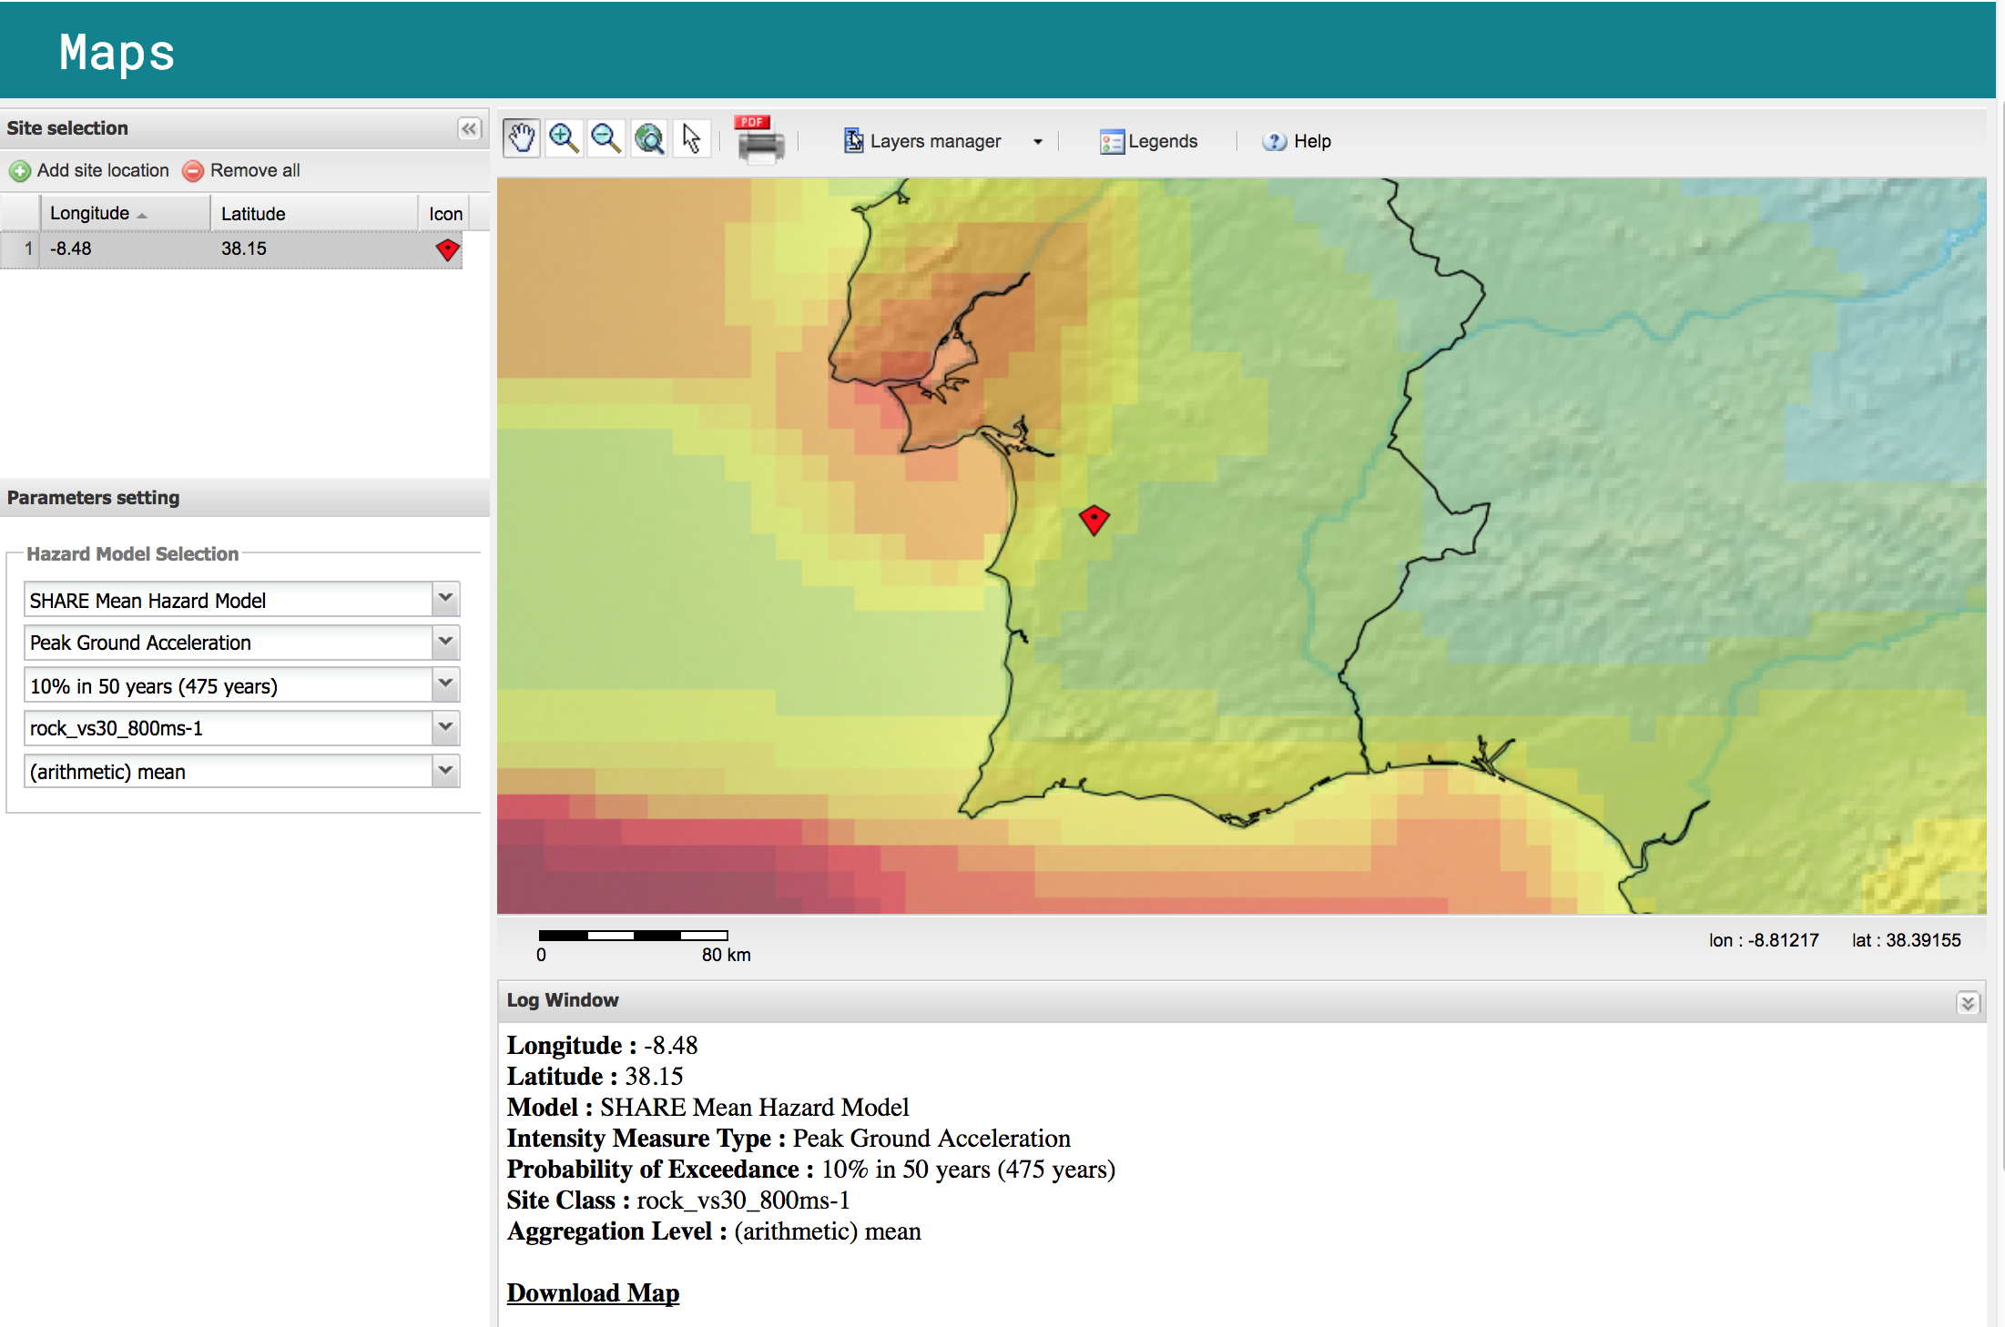
www.efehr.org

Slide 10
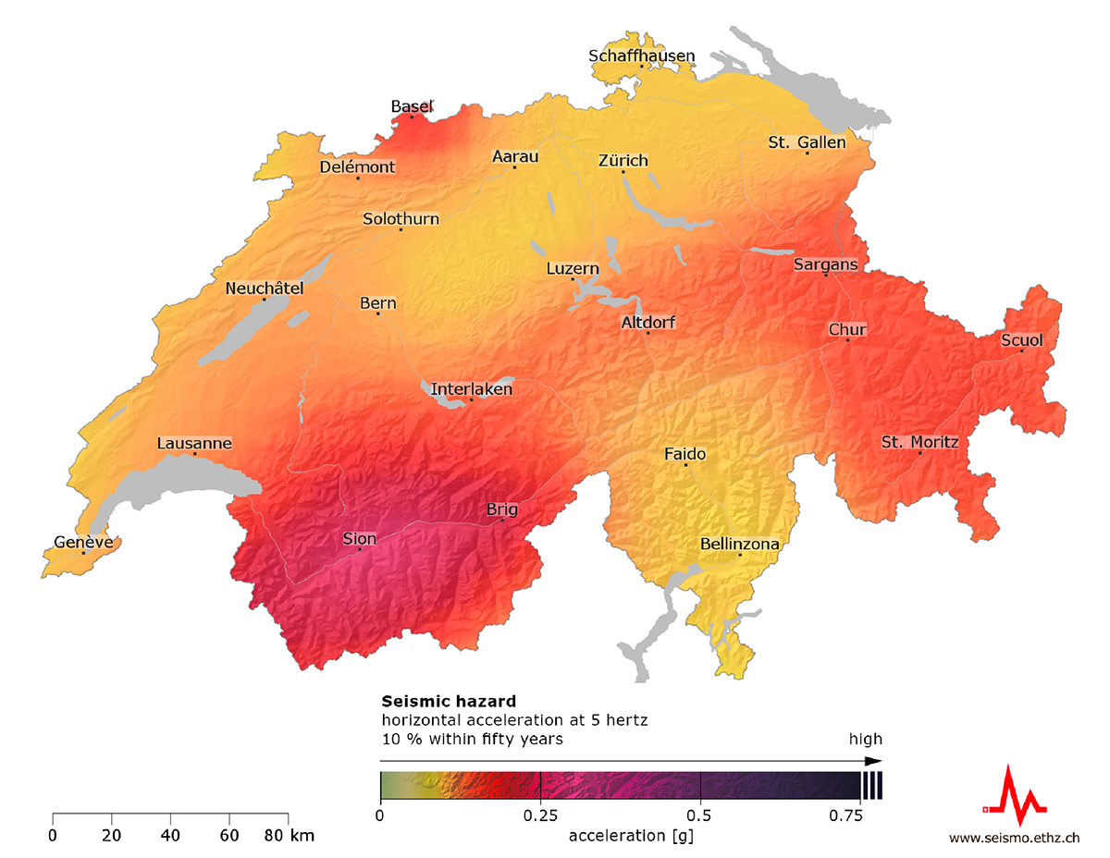
EFEHR web-portal: hazard maps
> 1000 Hazard Maps
Notes:
As i sad before, currently we provide

Slide 11
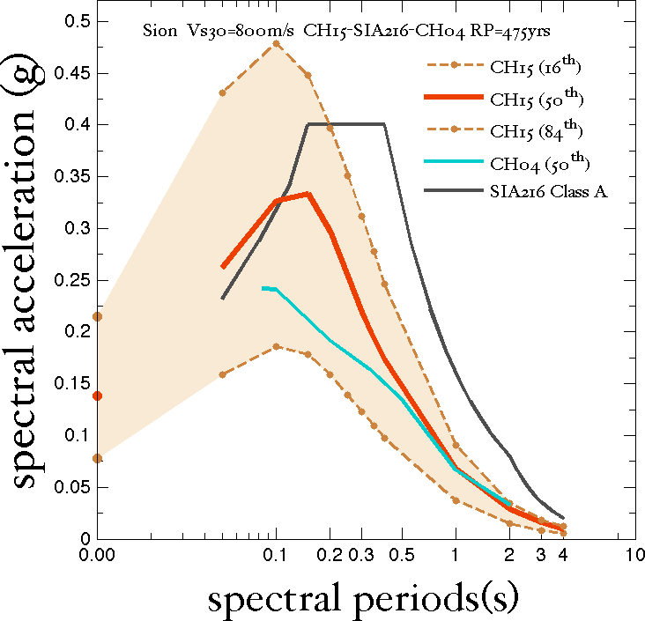
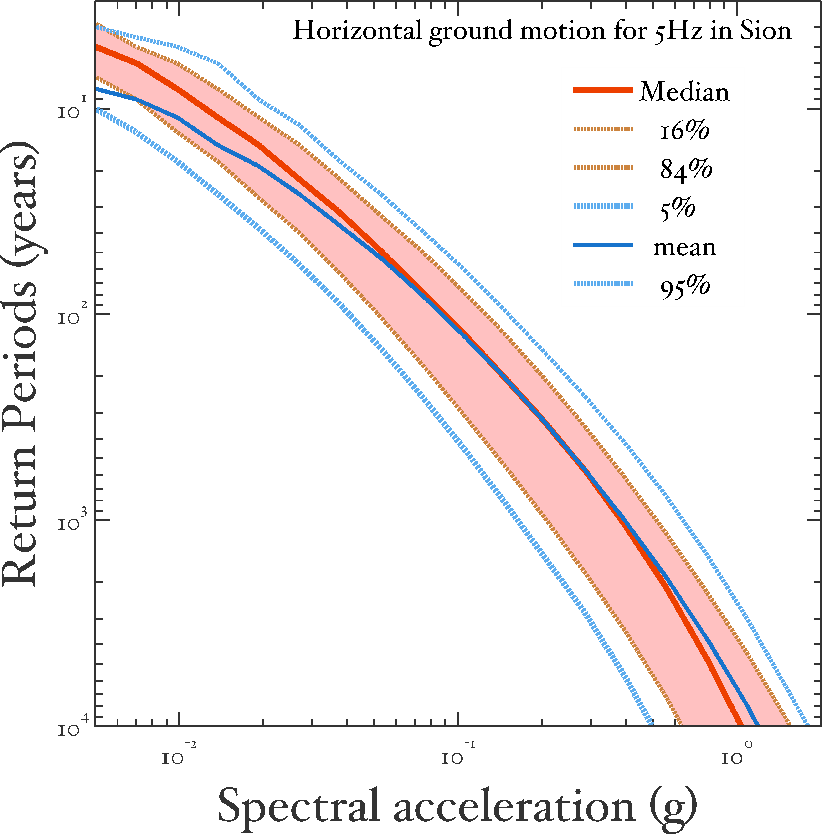
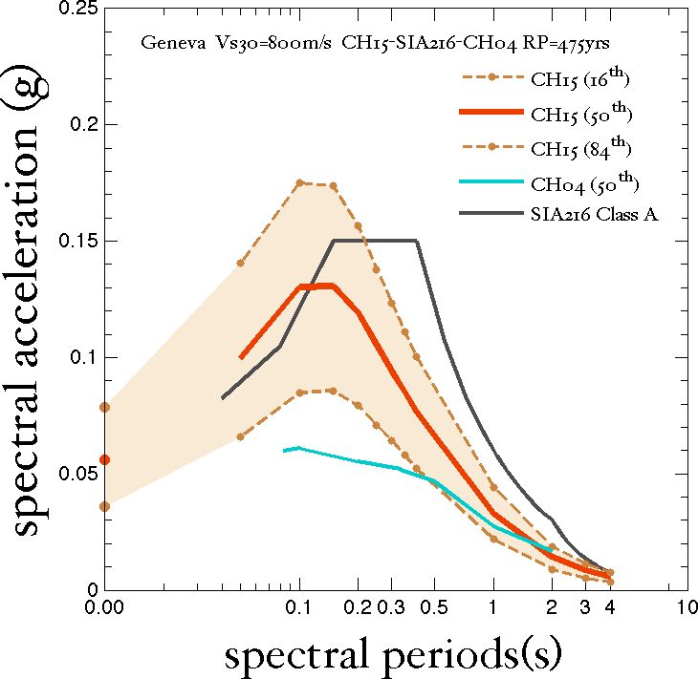
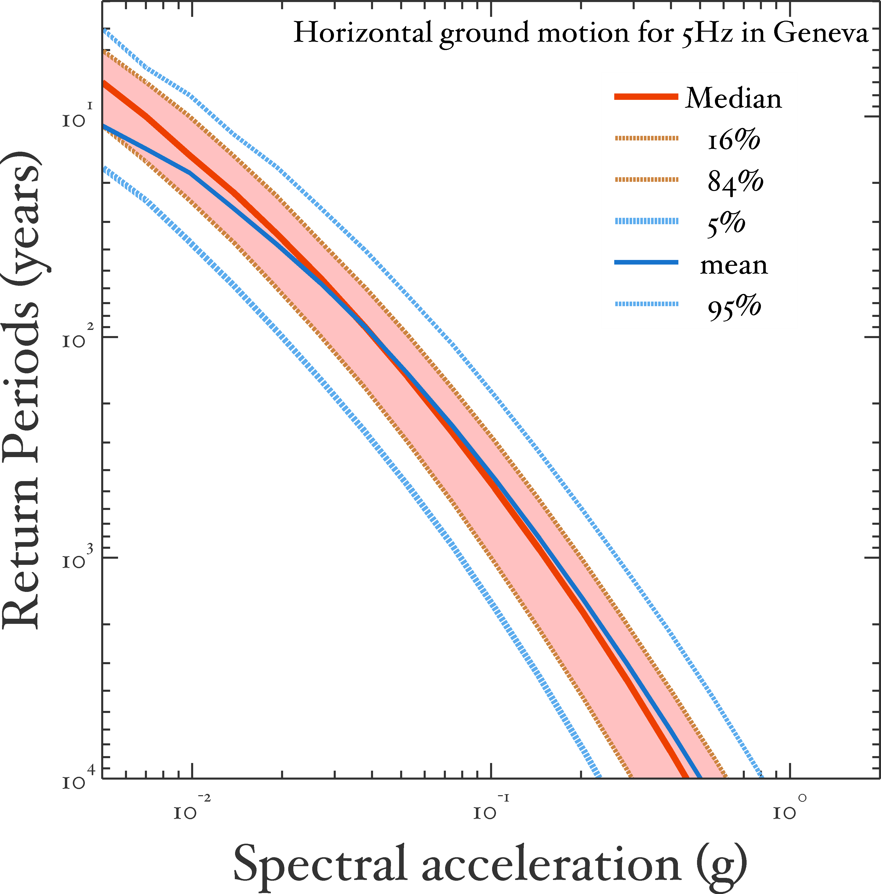
EFEHR web-portal: hazard curves and spectra

Slide 12
Services: European Database of Seismogenic Faults
http://www.seismofaults.eu/
(operational)

Slide 13
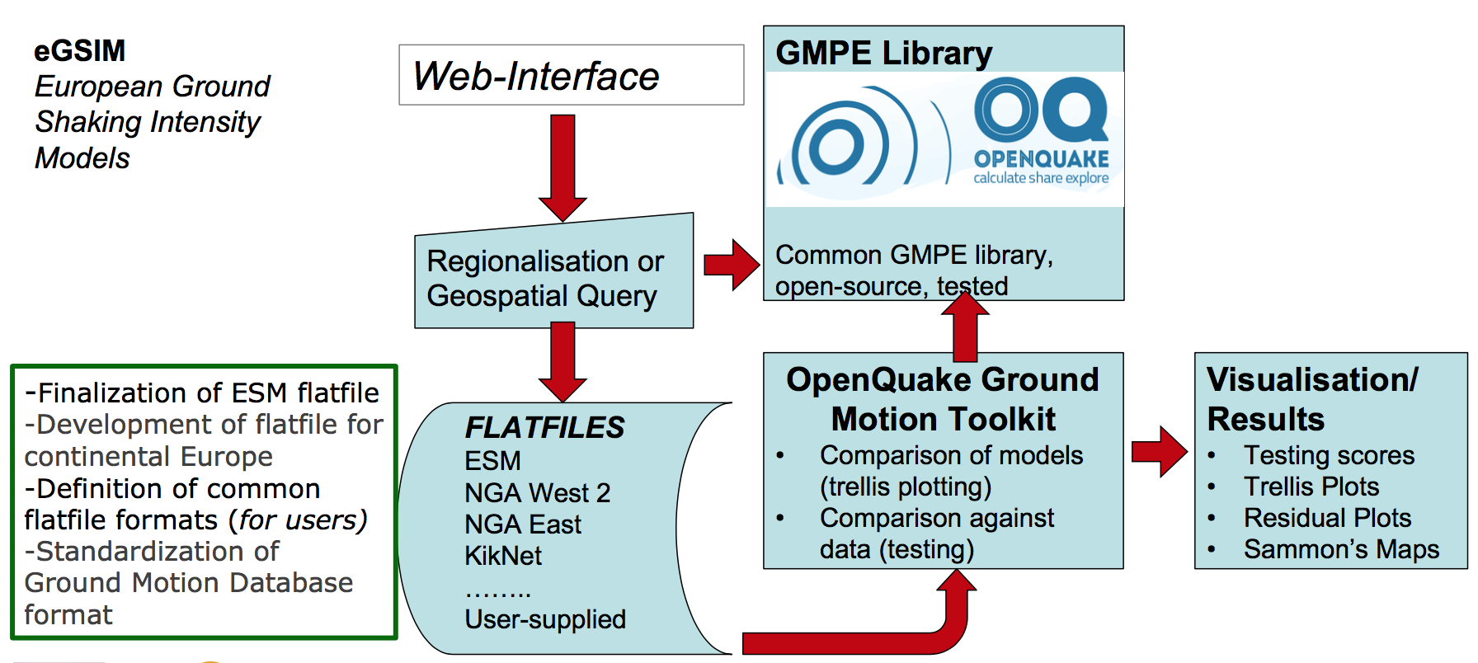
eGSIM: European Ground Shaking Intensity Models
(under development)
European European Ground Shaking Models: maintain and update a region specific logic tree of suitable ground motion prediction equation equations, validate the GMPEs against strong-motion data and integrating new intensity measures

Slide 14
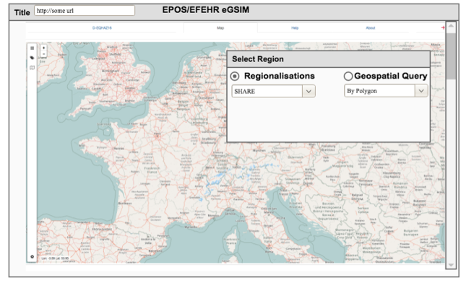
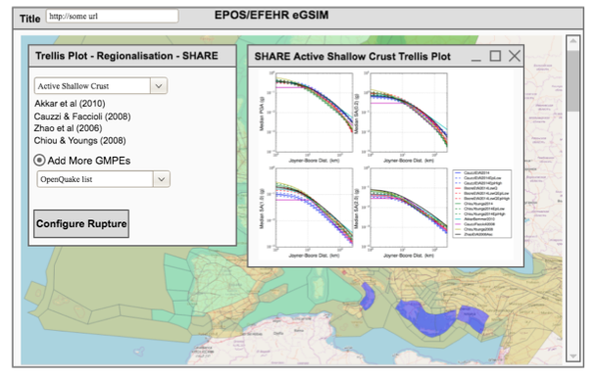
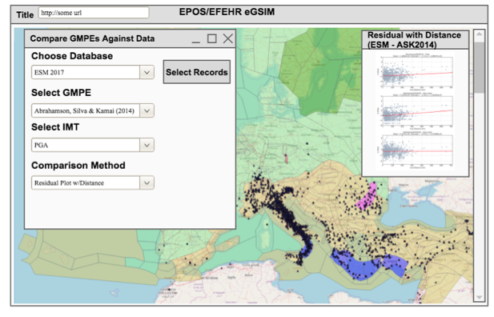
eGSIM: European Ground Shaking Intensity Models
(under development)
eGSIM

Slide 15
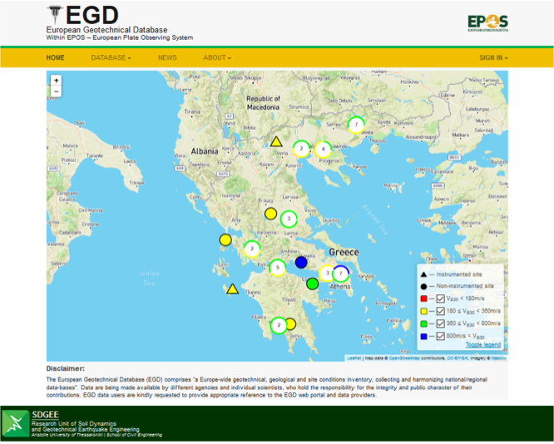
EGD: European Geotechnical Database
http://egd-epos.civil.auth.gr/
(under development)
The European Geotechnical Database (EGD) comprises “a Europe-wide geotechnical, geological and site conditions inventory, collecting and harmonising national/regional data-bases”.

Slide 16
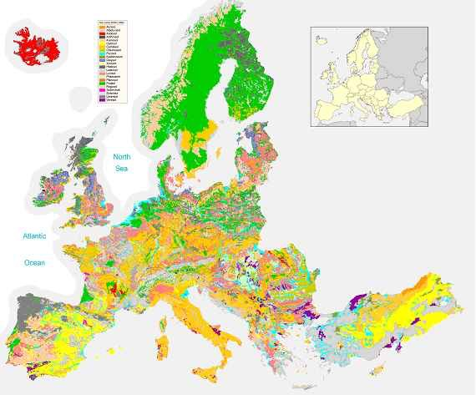
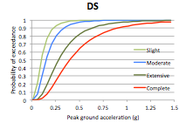
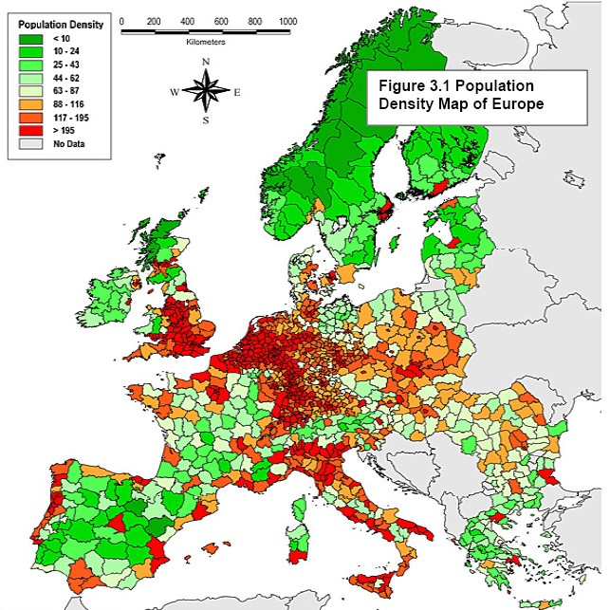
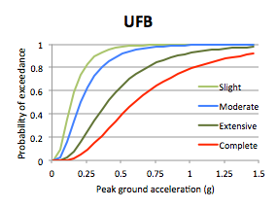
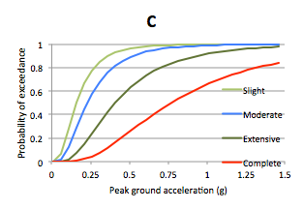
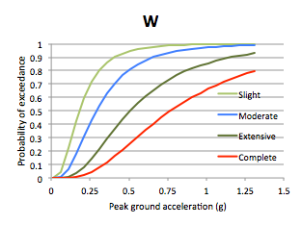
EU - Earthquake Risk
(under development)
Notes:
EFEHR’s architecture as designed within NERA project covers the main elements and data for seismic hazard & risk assessment: hazard, exposure, vulnerability and risk. Today, the web-platform provides access only to seismic hazard products

Slide 17
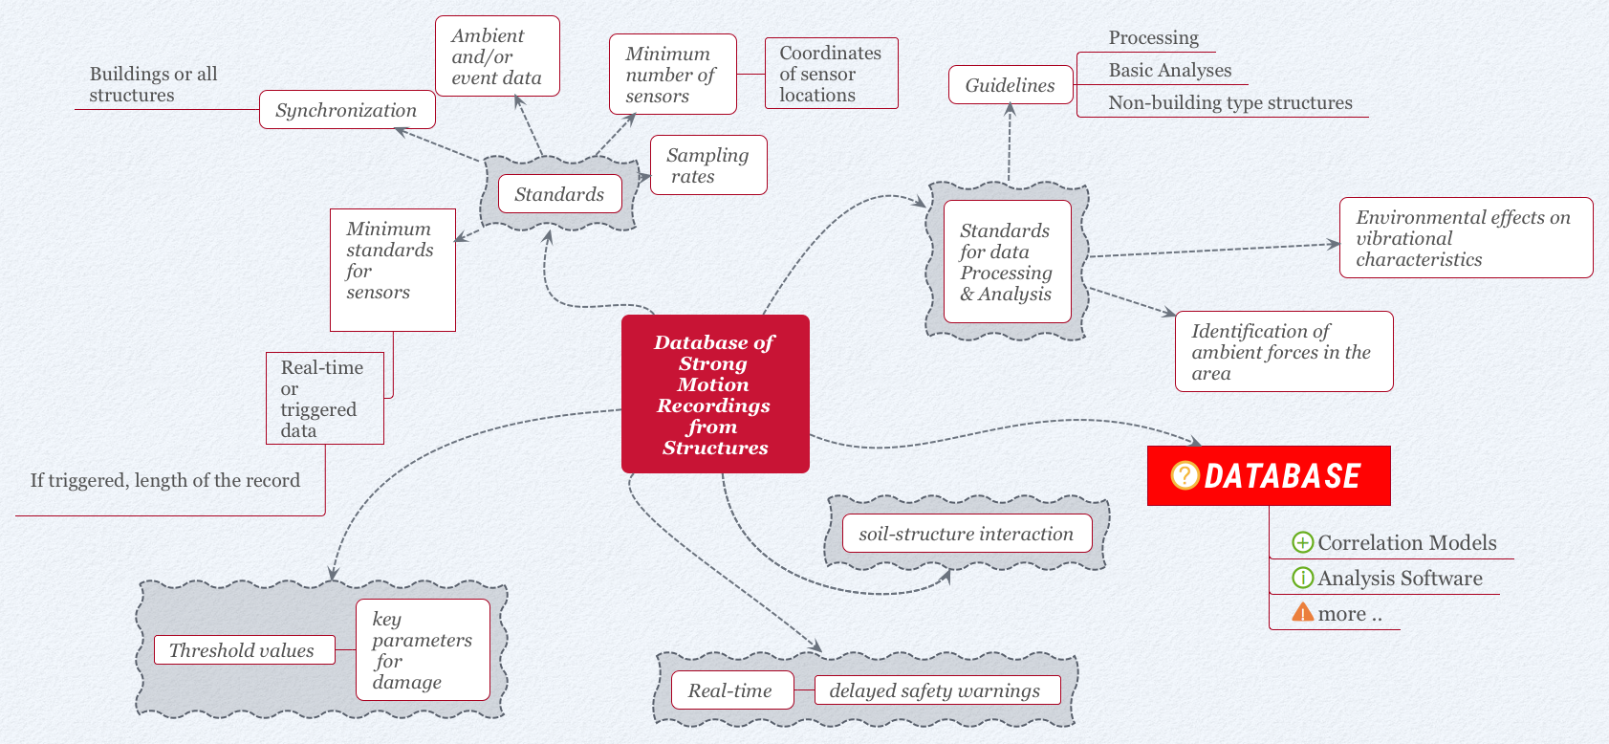
European Ground Motion Recordings in Buildings
(under development)

Slide 18
EFEHR.web services
Hazard Maps:
Representational state transfer (REST) or RESTful Web Services
OGC ( Open Geospatial Consortium) WebMap Server;
Layer metadata not by OGC metadata, but by inferring from discovery services
Services documented by Web Application Description Language (WADL)
Notes:
There are several web services implemented to enable the access of hazard maps, hazard curves, spectra and other hazard results.
The web-services for hazard maps are based on Restful API , the visualisation is OGC compliant and implementing a WebMap Server
The metadata is based on simple metadata for discovery, however not OGC compliant

Slide 19
EFEHR.web services
Hazard Curves/Spectra:
Representational state transfer (REST) or RESTful Web Services
Discovery response custom/ad-hoc; human readable, but not vocabulary based (e.g. SKOS)
Retrieval Response File Formats: NRML (GEM), CSV, Web Map Server (OGC-WMS) layers, Shape-Files (ESRI)
Services documented by Web Application Description Language (WADL)
Notes:
In a similar way, the web services for Hazard Curves and Spectra use the REST API for data discovery and retrieval services;
once discovered and selected the results can be obtained in various file formats including NRML - natural hazards f

Slide 20
EFEHR.web services
Hazard Products (Eq. Catalogues, Input files, raw data):
static file download; but discovery from interactive application rather than metadata search/service
Notes:
Additional products, such as harmonised catalogues, seimogenic sources, input for hazard calculation are provided by direct link for download.

Slide 21
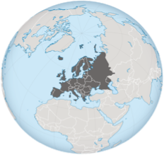
EFEHR.collaborative hub
- Act as a GEM Regional Centre of Capability
- Integration of the updated European Seismic Hazard Model with the forthcoming Global Seismic Hazard Model
- Collaboration on common standards for geo-hazards.
- Software development (OpenQuake, Modeller’s toolkit).
- Promote best practice and knowledge exchange within the research community.

Slide 22
EFEHR.next steps (JRA2,JRA3,JRA4)
ESHM02
ESHM13
ESHM18
Conduct periodic review of EU hazard model and results, providing updated models when needed, thus moving to a dynamic seismic hazard model.
The revised European Seismic Hazard Model (ESHM18, JRA3) will provide the seismic actions for the revision of the Eurocode 8, and reference for the revision of the national hazard models.

Slide 23
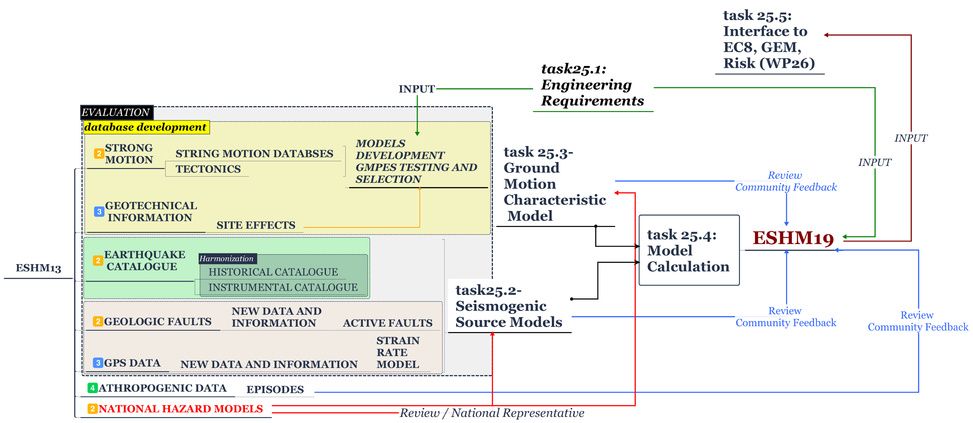
EFEHR.next steps (JRA2,JRA3,JRA4)
ESHM18/19: Master Flowchart

Slide 24
EFEHR.next steps
Continue the integration of data, services and software with EPOS ICS (Integrated Core Services) and across other Thematic Core Services (TCS).
December (2017): become EPOS metadata compliant
Attributes specific to the dataset or data product | Data Type | European Facilities for Seismic Hazard and Risk
Unique Resource Identifier |  | European Facilities for Seismic Hazard and Risk (EFEHR)
Organization |  | ETH Zurich
Name | String | originator, distributor, custodian
Role | String
ID | Organization | http://www.efehr.org/
Website | String | Earth Science, Seimology
Science domain | String
Contact | String | L.
Given Name | String | Danciu
Last Name | double | orcid.org/0000-0003-4086-8755
ID
Facility Manager | String
Given Name | String
Last Name | String
ID | String | EFEHR is designed as a sustainable community resource for European Earthquake Hazard and Risk. The EFEHR web platform provides access to data, models, tools and expertise relevant for assessment of seismic hazard and risk in Europe. EFEHR is hosted at ETH Zurich and operated by the Swiss Seismological Service (Schweizerischer Erdbebendienst SED), in close collaboration with EUCENTRE Pavia.
Related Sources | String
Notes:
From the technical point of view, the integration with IPOS ICS and TCS will continue with a focus on metadata harmonisation, which is planned this fall in September….

Slide 25
EFEHR.hands-on
web-platform upgraded (M6)
hands-on this afternoon
Notes:
Main areas of development include the web-interface and data visualisation.
The work on the EFEHR portal upgrade has started with investigations into available technology/software to improve the user interface / user experience.

Slide 26
thank you!
Laurentiu Danciu
laurentiu.danciu@sed.ethz.ch
Notes:
with this i would like to thank you, and wish you a very successful project!
Thank you

