Slide 1
EPOS-GNSS services status and developments
R. Fernandes¹, M. Bos¹, C. Bruyninx², P. Crocker¹, J. Dousa³, A. Walpersdorf⁴, A. Socquet⁴, A. Avallone⁵, A. Ganas⁶, C. Ionescu⁷, A. Kenyeres⁸, B. Ofeigsson⁹, H. Ozener¹⁰, M. Vergnolle¹¹, M. Lidberg¹², T. Liwosz¹³, W. Soehne¹⁴, P. Bezdeka³, R. Cardoso¹, N. Cotte⁴, R. Couto¹, N. D’Agostino⁵, A. Deprez⁴, A. Fabian², L. Féres¹, J. Legrand², J.-L. Menut¹¹, E. Nastase⁷, K.-M. Ngo¹¹, F. Sigurðarson⁹, P. Vaclavovic³
1. UBI/C4G, Covilhã, Portugal 2. ROB, Brussels, Belgium
3. GOP, Pezny, Czech Republic 4. CNRS-UGA, Grenoble, France
5. INGV, Rome, Italy 6. NOA, Athens, Greece
7. INCDFP RA, Bucharest, Romania 8. BFKH, Budapest, Hungary
9. IMO, Reykjavik, Iceland 10. KOERI, Istanbul, Turkey
11. CNRS-OCA, Nice, France, 12. LM, Gävle, Sweden
13. WUT, Warsaw, Poland 14. BKG, Frankfurt-am-Main, Germany
wp10@epos-ip.eu

Slide 2
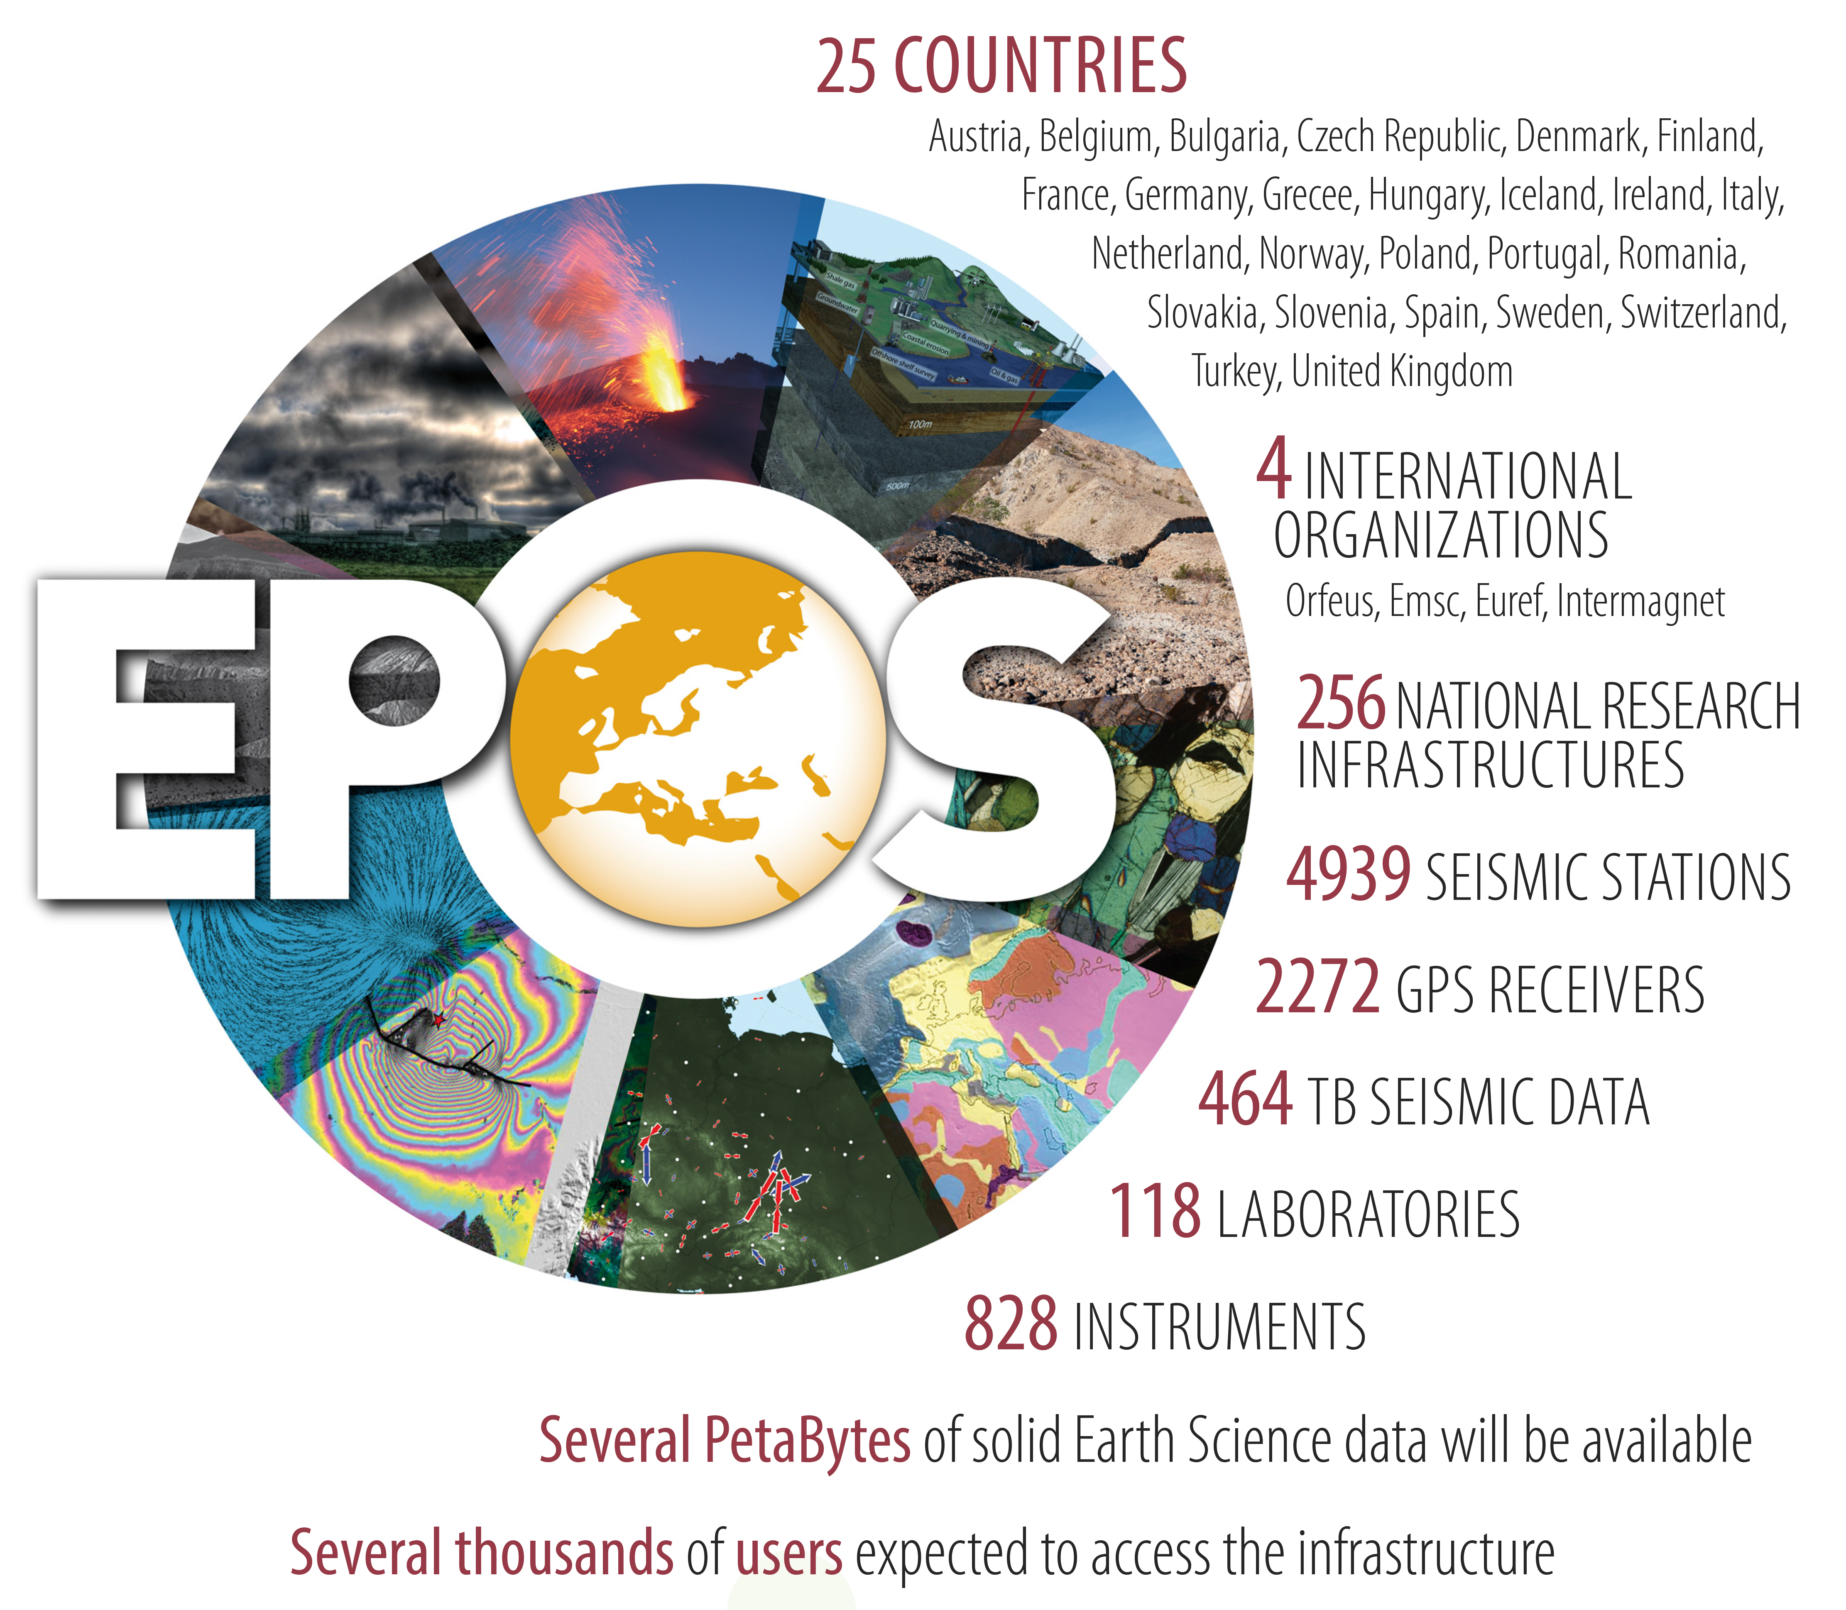
What is EPOS?
EPOS is a long-term project for the integration
of research infrastructures for Solid Earth Science in Europe
One of the three priority projects of European Commission within ESFRI
EPOS integrates the
existing (and future) advanced European facilities into
a single, distributed,
sustainable infrastructure
taking full advantage of new e-science opportunities

Slide 3
Functional Architecture
National Research Infrastructures (NRI)
Thematic Core Services (TCS)
Integrated Core Services (ICS)
How will EPOS work?
community-specific integration
novel e-infrastructure
Computational
Resources
Interoperability
Brokerage
Data generation & standardization
Sustainability and operation
Quality checked repositories
Thematic integration
Engagement of communities
Community service provision
Metadata registry
Processing
Aggregation
Integrated analyses
Visualization

Slide 4
EPOS Today
Each of the communities (e.g. GNSS) gets organized:
Set up their governance (to speak with ‘one voice’ in EPOS)
Define the data and data products to provide to the EPOS portal
Construct the (IT) interfaces between their community and the EPOS portal
GNSS
Contribution based on collaboration between the geodetic/geophysical community including EUREF

Slide 5
Objectives EPOS-IP (Implementation Phase) WP10 – GNSS Data & Products
Objective | Status
construct the future governance of TCS GNSS Data & Products in EPOS; | Agreement of Governance Structure
interact with the geodetic community in Europe, at national and Pan-European (EUREF) levels; | Communication channels with Geodetic Community established.
ensure interoperability between EPOS GNSS services (data and products) and EPOS ICS; | Detailed DDSS to be implemented during the EPOS-IP phase defined.
promote multidisciplinary interoperability with other disciplines within EPOS; | Contacts with WP09 (Near-Fault) and WP11 (Volcanos) about GNSS data management
implement distributed dissemination of file-based GNSS data for about 2000 stations (and and derived Products: CRD, VEL, STR) in the first 2 years with the goal of reaching 3000 by the end of the EPOS-IP. | GLASS software (including Data & Products Portal) being developed. Prototype Products tested.

Slide 6
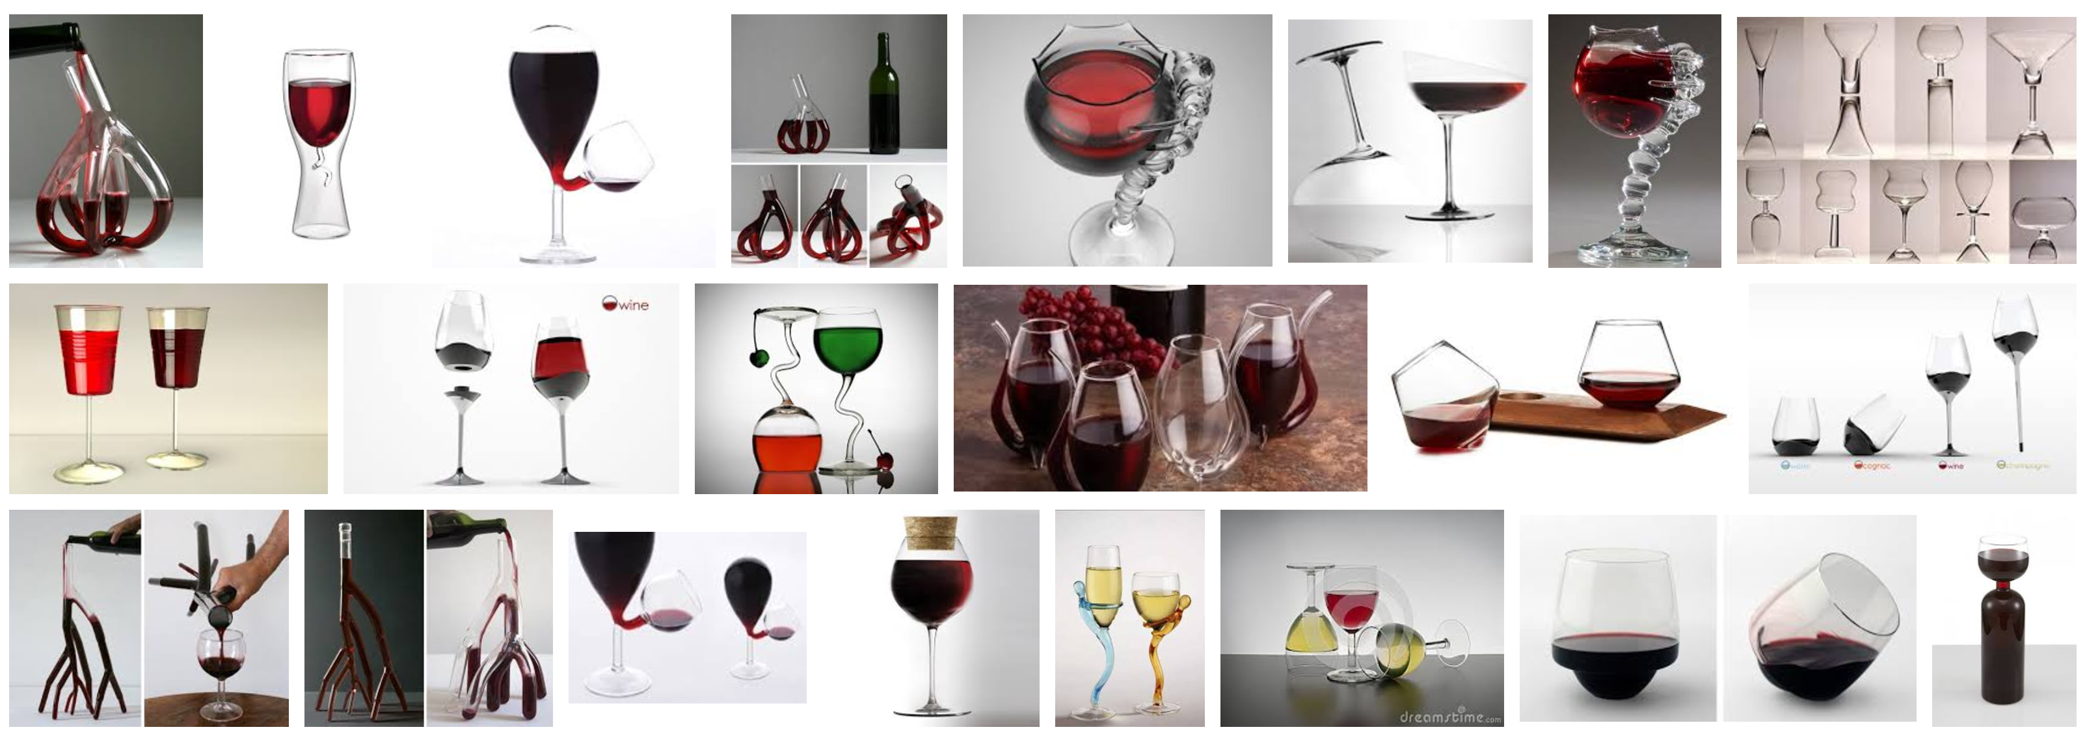
GLASS – What and Why?

Slide 7
GLASS – What and Why?
GNSS Linkage Advanced Software System
GLASS intends to be an integrated software package to be deployed in a GNSS infrastructure to:
Manage GNSS data (RINEX & metadata) from distributed repositories/data centers:
Collect data
Validate data
Disseminate data
Provide GNSS products:
Coordinate Daily and Time Series
Velocity Fields
Strain Rate Fields

Slide 8
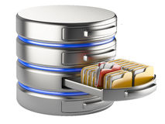
GLASS – components
GLASS encompass the following key elements:
Physical components – repositories/data centers
Primary - default repository, decided by the data provider
Secondary - alternative repository
Mirror - a repository that act as a mirror of another
Web services – portals, monitoring tools, data and products mining solutions
Software applications – managing interactions between repositories and services

Slide 9
GLASS work flow
USERS
M3G
Center
GNSS Data Gateway
EPOS
GNSS Products
Gateway
station metadata added to database
GLASS
GLASS
New station
metadata
New RINEX
metadata
Strain rates
GLASS
RINEX files
Positions,
velocities
velocities
GNSS data provider
GNSS analysis center
GNSS analysis center
PROVIDERS

Slide 10
RINEX Repositories / Data Centers
RINEX Repository
(Data Center)
RINEX Data: need to be available (local or external – url link) and GLASS will run on top of it (no need to adapt directory structure).
FILES
GLASS software will act when a new file become available by:
Checking the file metadata (Header) against the the Site metadata (Anubis)
Run additional checks on file contents (Anubis)
Provides the url location to the data portal (local and externals)
GLASS Applications
M3G
Metadata Monitoring
Site Information
RINEX
FILE
Data Quality
Long term
data monotoring
url location
Data Portal(s)

Slide 11
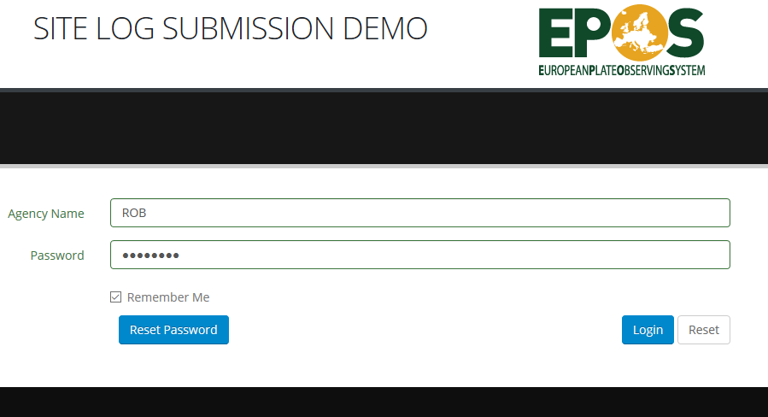
M3G – Metadata Management system for Multiple GNSS Networks to be maintained by ROB - Belgium

Slide 12
M3G – Metadata Management system for Multiple GNSS Networks
View current log
Update site log
Export site log
Import site log from local disk

Slide 13
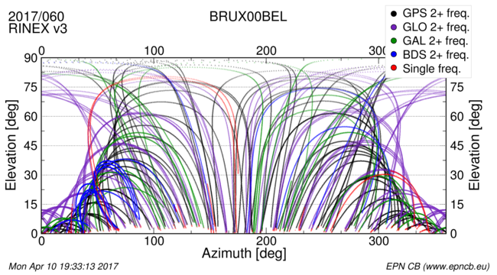
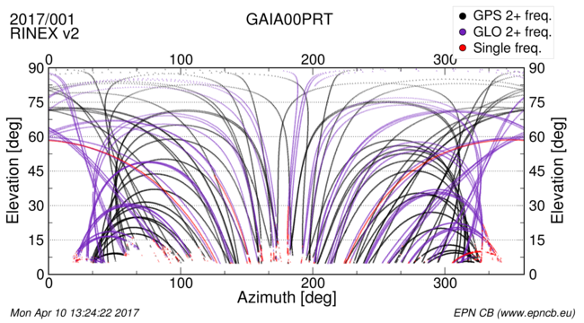
Long-Term Monitoring Center to be maintained by ROB - Belgium
Observed phase data for all constellations. Input are the station daily RINEX 2/3 observation files. The graphs give a snapshot of the station tracking for a specific date.

Slide 14
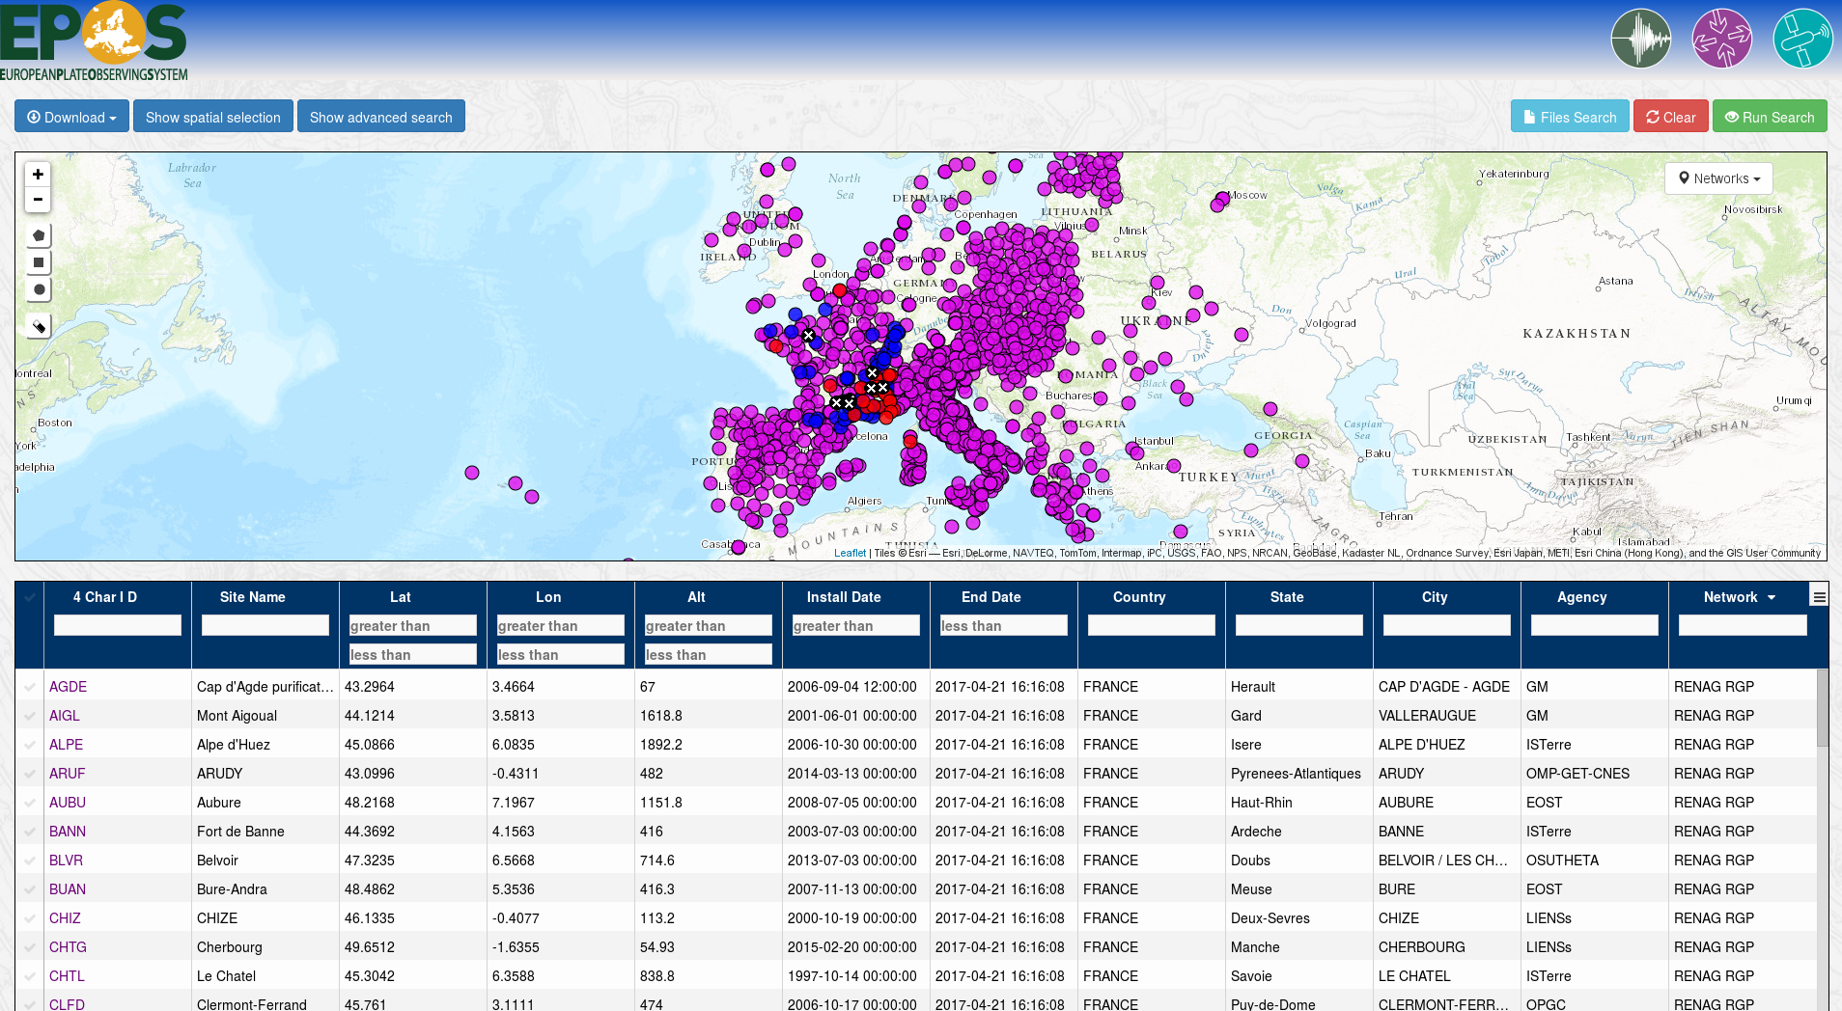
Data Portal to be maintained by CNRS - France
DEMO
Notes:
Notes :
Different colors = differents networks
To makes things easier only RENAG stations are shown in the spreadsheet

Slide 15
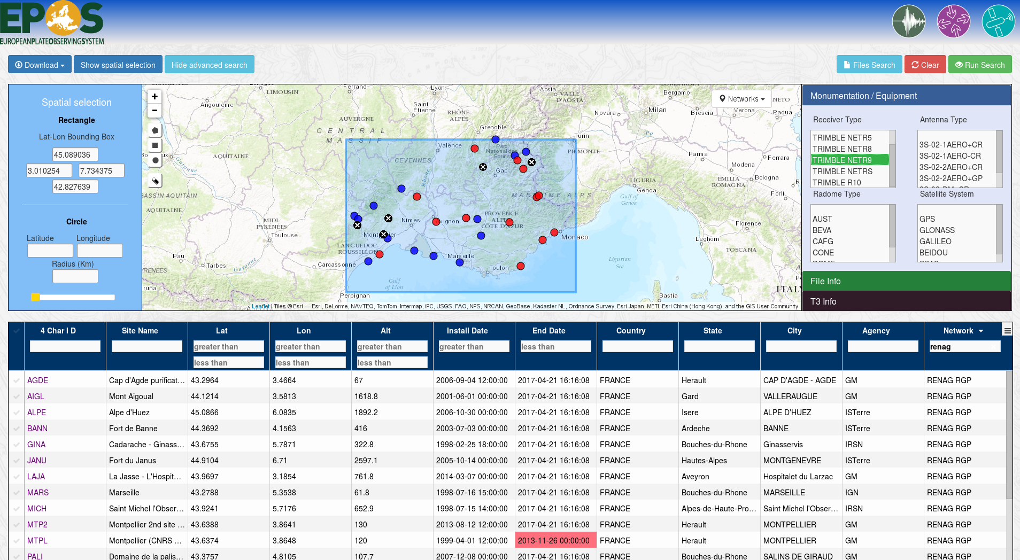
Data Portal
❸
DEMO
❷
❶
Notes:
S-E France is selected with the rectangle tool (interface updated in real time)
TRIMBLE NETR9 is selected in the receiver type window of the advance search panel (doesn’t update the inerface)
The spreadsheet is filtered for RENAG (interface updated in real time)

Slide 16
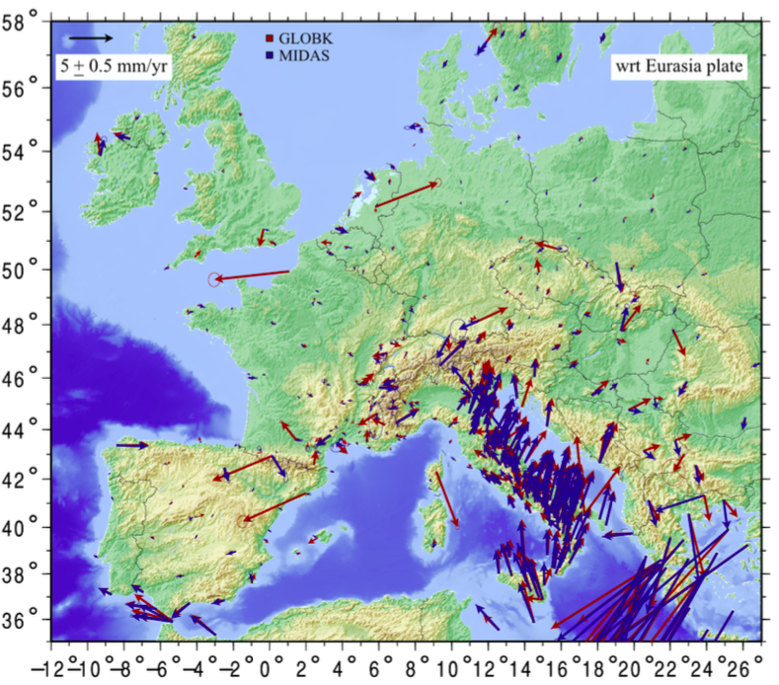
EPOS-GNSS Products
Current status: Prototype Products already generated
Daily solutions + metadata
run by 2 Pan-European processing centers (INGV, UGA-CNRS)
densified solution EUREF (BFKH)
Daily time-series & velocity fields + metadata
Individual Solutions (INGV, UGA-CNRS)
Combined Solution (BFKH)
Strain Rate maps + metadata
Global + Regionals (LM)

Slide 17
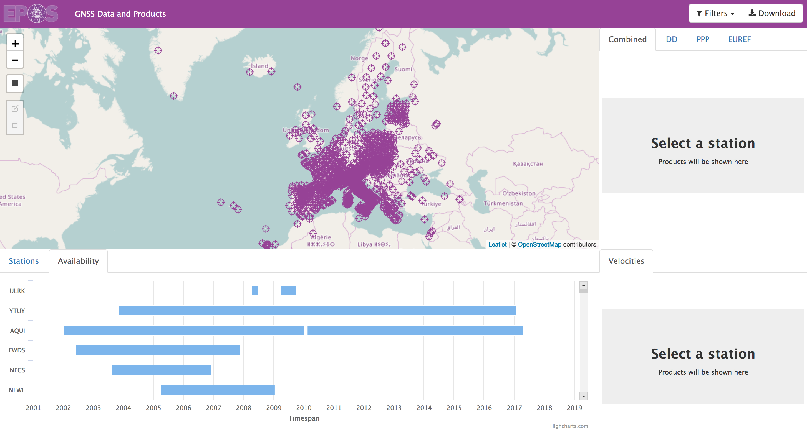
Products Portal
to be maintained by UBI/C4G – Portugal
DEMO

Slide 18
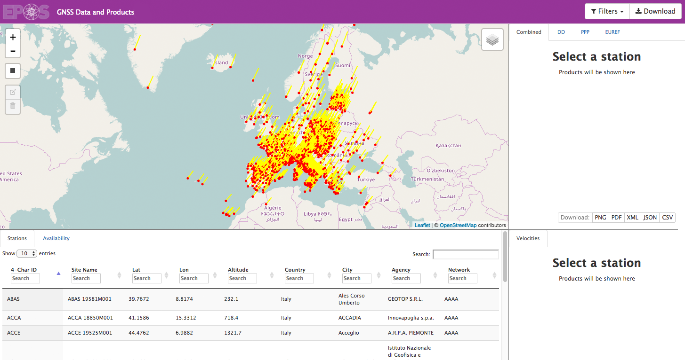
Products Portal
DEMO

Slide 19
Products Portal
DEMO

Slide 20
Summary
GLASS is a software package to manage, validate, and distribute GNSS data & metadata and associated products.
GLASS is being developed in the framework of EPOS-IP (Implementation Phase, until 2019).
GLASS will be used in the GNSS component of EPOS-OP (Operational Phase, after 2019).
We have shown the major components:
Repository Software
M3G software
Data & Products Portals
All these components work together in a complete package (can be installed in a stand-alone server but the goal is to facilitate the integration of individual repositories/data centers.
First version available for testing in 2018 – interested people can contact us:
wp10@epos-ip.eu

Slide 21
Thank you for your attention Questions?

