Slide 1
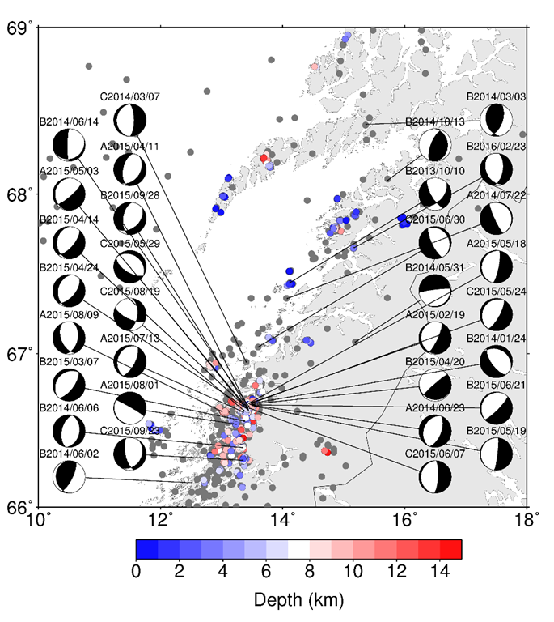
Research interests jan.michalek@uib.no
Local seismicity in different regions:
West Bohemia (Czechia)
Reykjanes (Iceland)
Nordland (Norway)

Slide 2
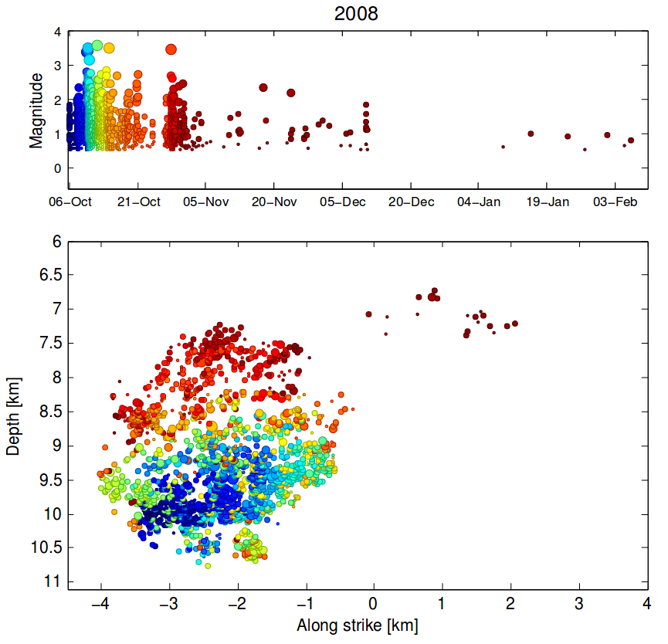
Research interests jan.michalek@uib.no
West Bohemia (Czechia)

Slide 3
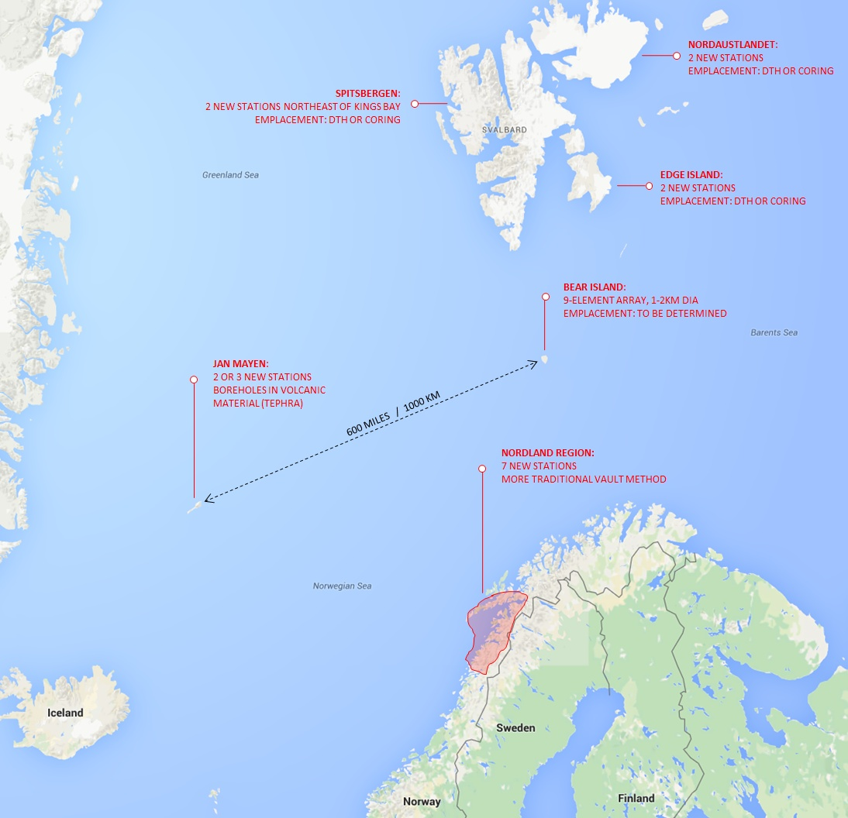
EPOS-N project
European Plate Observing System – Norway
Develop e‑infrastructure
EPOS-N
Components
Improve monitoring capacity in the Arctic
Establish Solid Earth Science Forum

Slide 4
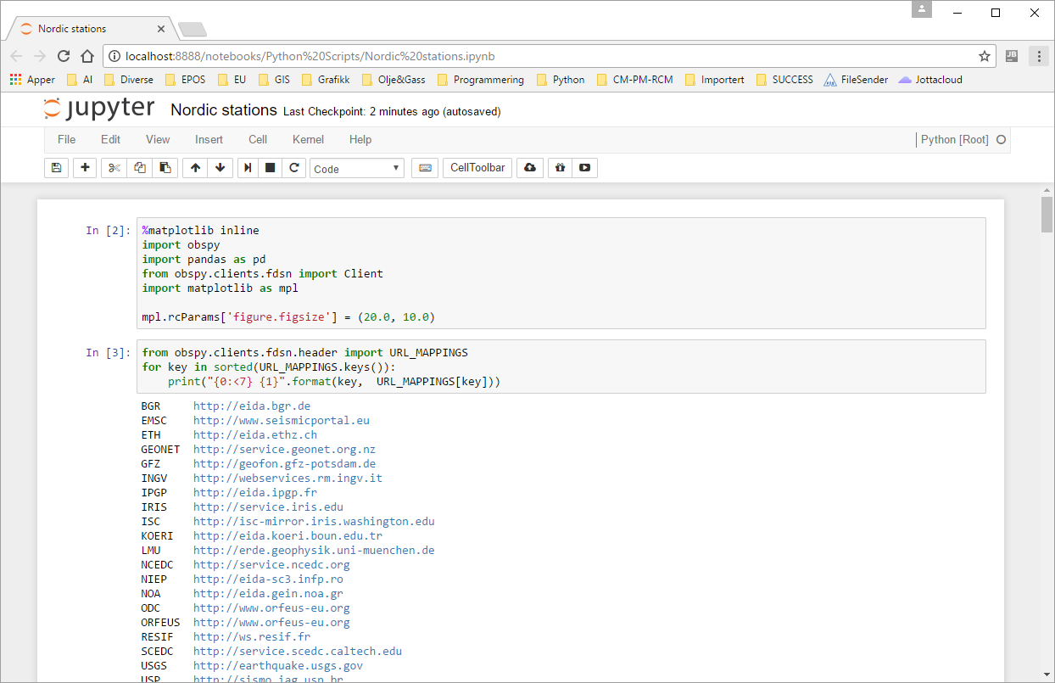
Jupyter Notebook example (1)
Notes:
This example shows a notebook running in the web browser. Code is entered and executed in cells. Celles can be edited and rerun. New cells can be inserted. Cells can be deleted. Here a cell with import of libraries we will need.
Then we import URL mappings and list all available EIDA nodes with corresponding URLs.

Slide 5
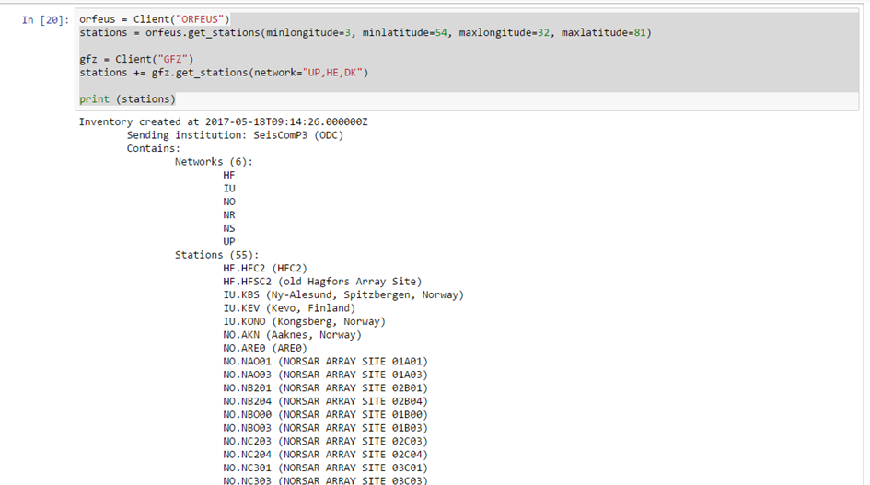
Jupyter Notebook example (2)
Notes:
We create ObsPy clients for Orfeus and GFZ, and query station information based on geographic area and network names to get a collection of Nordic stations. We use the ObsPy method get_stations for these queries. The resulting data set consisting of data for the stations could then easily be made available in Enlighten-web. Inserted is a plot of the stations in Enlighten-web.

Slide 6
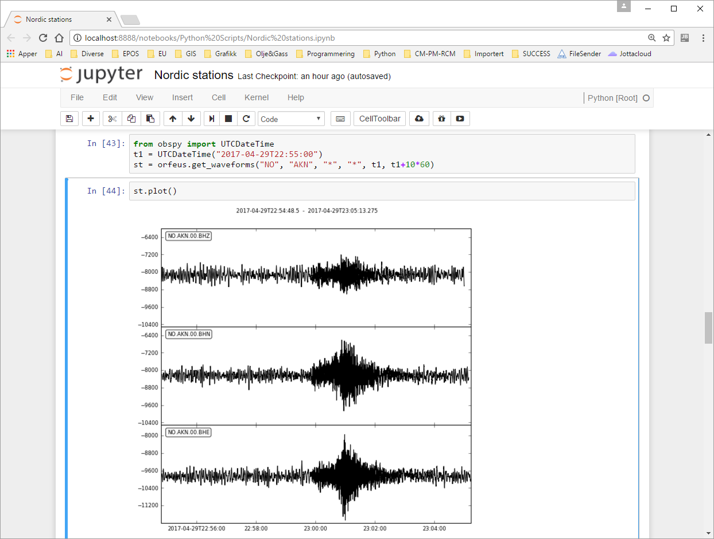
Jupyter Notebook example (3)
Notes:
Figure 4 shows a simple example of retrieving waveforms for a specific station for a specific time range. We use the ObsPy method get_waveforms for these queries.

Slide 7
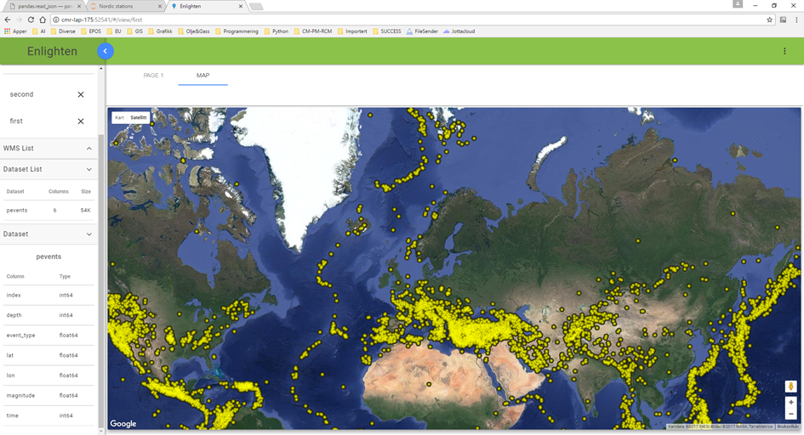
Enlighten – web client (1)

Slide 8
Enlighten – web client (2)

Slide 9
Brushing and linking

